Slide 1
creos syntogain
Customer facing presentation

Slide 2
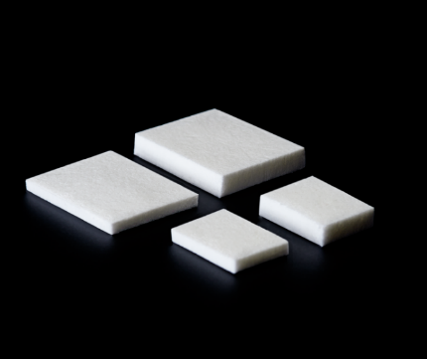
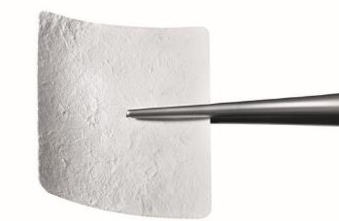
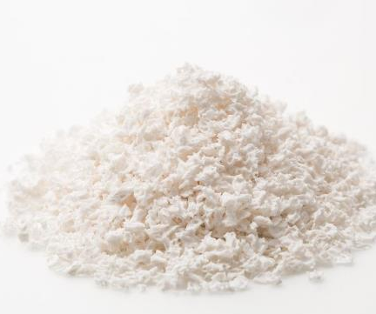
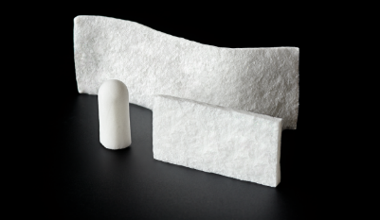
Membranes
creos™ xenoprotect
creos™ syntoprotect
creos™ allo.protect
Matrix
creos™ mucogain
creos™ biomaterials
a comprehensive portfolio for soft tissue & bone regeneration
Wound Dressings
creos™ xenoplug
creos™ xenocote
creos™ xenotape
Bone Graft Substitutes
creos™ xenogain
creos™ syntogain
creos™ allo.gain
InterOss® (SigmaGraft)
5/12/2022
2
Notes:
Creos portfolio is split in four categories:
Membranes : with creos xenoprotect and allo.protect.
Collagen Matrix: with creos mucogain.
Wound dressings: xenoplug, xenocote, xenotape. Those products are sold in USA and CA only, for the time being.
Bone graft substitutes: with creos xenogain and creos allo.gain.
Difference between xenogain and allogain is that xenogain is from a different species (bovine), while allogain originates from humans.
Today’s presentation is about creos xenogain, one of our bone graft substitute.

Slide 3
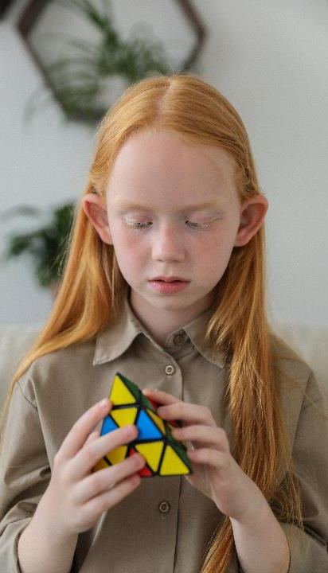

Four things than clinicians expect from regenerative products
Easy handling
Limited choice of products
Quality customer service
Availability of Nobel Biocare representative
Easy
Fair price
Practice growth
It works
Peace of mind
Clinical data
Product quality
Predictable results
Implant success
Good value for money
Training & Education
Innovations
Efficiency
5/12/2022
3

Slide 4


creos™ syntogain –
Biomimetic bone graft substitute for efficient regeneration

Slide 5



creos syntogain − Features & benefits
Advanced manufacturing process
Hydrothermal
Low temperature (different from others)
1
Unique composition of the material
    80 % of Calcium Deficient Hydroxyapatite (CDHA)
    20% of β-TCP (beta-tricalcium phosphate)
    Biomimetic: mimics human bone (made of CDHA)
2
Microscopic surface of the material is made of nanocrystals:
    High specific surface area: enhances the cells to attach
    High microporosity: enhancing bone ingrowth
3
The bone is stable
    Maintains the volume of the defect
5/12/2022
5

Slide 6
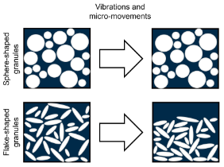
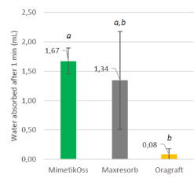
creos syntogain − Features & benefits
In addition:
A unique round shape of the granules
  Making it easy to apply in situ.
  Avoiding stacking effect.
High hydrophilicity
  Allowing an easy hydration.
  Easy granule handling.
It is non-sintered
  Micropores and osteoconductivity are not reduced.
One of the largest Randomized Clinical Trials performed in dental bone regeneration:
  creos™ syntogain showed equivalence with reference product (Bio-Oss®).
Average quantity of absorbed water by 3 cc of BGS after stabilisation
5/12/2022
6

Slide 7
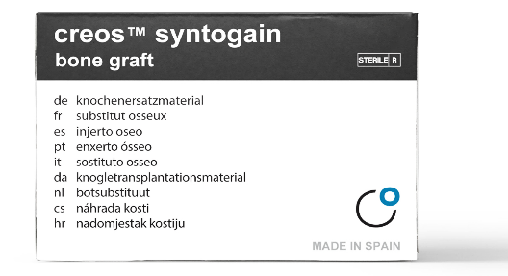
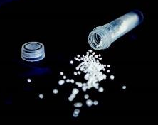
The product
Synthetic bone graft.
Products already CE-marked, no FDA clearance yet.
Distributed product (original product named “MimetikOss”).
Exclusive OEM business.
Non-inferiority to Bio-Oss established through the clinical study.
Reasons to buy:
  Clinician preference.
  Patient preference (religious reasons, non-animal-based product, vegan).
Article n° Mimetis | Article n° Nobel Biocare
MIM-S-0.5 | S1110 | creos syntogain 0.2-1.0mm 0.5cc
MIM-M-0.5 | S1111 | creos syntogain 1.0-2.0mm 0.5cc
MIM-S-1 | S1120 | creos syntogain 0.2-1.0mm 1cc
MIM-M-1 | S1121 | creos syntogain 1.0-2.0mm 1cc
MIM-S-2 | S1130 | creos syntogain 0.2-1.0mm 2cc vial
MIM-M-2 | S1131 | creos syntogain 1.0-2.0mm 2cc vial

Slide 8
Advanced manufacturing process

Slide 9
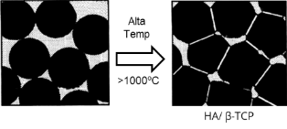
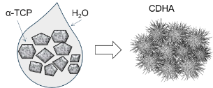
Advanced manufacturing process
 | Natural bone | Traditional calcium phosphate (HA / β-TCP) | Biomimetic calcium phosphate (CDHA / β-TCP)
Composition | Calcium deficient hydroxyapatite | Hydroxyapatite β-TCP | Calcium deficient hydroxyapatite β-TCP
Elaboration | biomineralization = precipitation of nanocrystal of CDHA at body temperature | mix of powder sintered at high temperature ([800-1400ºC]) | low-temperature dissolution–precipitation reactions in aqueous system that mimic the biomineralization phenomena (<150ºC)
Slide example
with table and takeaway message
High
temp.
Manufacturing process mimics the physiological events naturally occurring in healthy bone.

Slide 10
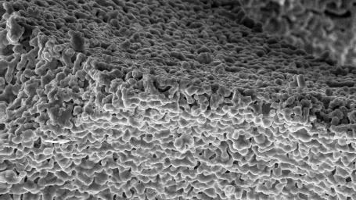
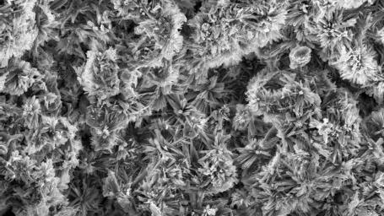


Technology base – Synthetic bone graft generalities
Biomimetic calcium deficient HA vs traditional sintered HA
      Main differentiation of creos syntogain granules is the manufacturing process leading to the precipitation of Calcium Deficient Hydroxyapatite (CDHA)
CURRENT
SYNTHETICS
High-temperature, passivated materials, unable to interact with the host
BIOMIMETIC
Similar to the mineral phase of bone. Calcium deficient hydroxyapatite crystals grow slowly at low temperature to mimic the structure and composition of human bone.

Slide 11
Product features

Slide 12
Unique composition of the material that is biomimetic
80 % of Calcium Deficient Hydroxyapatite (CDHA)
20% of β-TCP (beta-tricalcium phosphate).
Biomimetic: mimics human bone that is also made of CDHA.
The closer a material resembles human bone, the better it is for bone formation.
5/12/2022
12
Notes:
*Barba A, Diez-Escudero A, Espanol M, et al. The impact of biomimicry in the design of osteoinductive bone substitutes: nanoscale matters. ACS Appl. Mater. Interfaces 2019. DOI:10.1021/acsami.8b20749.
**Rufino Senra M, de Fátima Vieira Marques M. Synthetic Polymeric Materials for Bone Replacement. J. Compos. Sci. 2020,4, 191;doi:10.3390/jcs4040191.

Slide 13
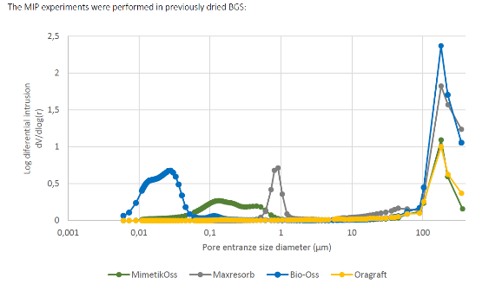
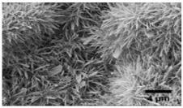
Microscopic surface made of nanocrystals
High specific surface area
→ helps the cells to attach for the bone generation.
The specific surface area was measured by nitrogen adsorption
High microporosity → enhancing bone ingrowth.
Natural bone (Bio-Oss, xenograft) starts in the nanometer size scale. – comparable to human bone.
creos syntogain has pore sizes in the nanometer size scale, which is not the case with another classic sintered calcium phosphate.
A nano/micro porosity similar to the natural bone’s structure allows good inflow of blood, cell colonization and reliable bone formation.
creos syntogain mimics the natural porosity of bone.
Pore volume distribution
Nanometer size scale
  CDHA crystallinity
5/12/2022
13
Notes:
The pore volume distribution over pore diameter is expressed in terms of the distribution function Fv
Fv = - (dV / d log D) where V is pore volume. The function is such that area under the function in any pore diameter range yields volume of pores in that range.
The calcium phosphate apatite in our bone mineral is around 50-100 nanometers size scale, creos sytogain is of that size scale.
The body will see that as something closer to bone mineral and be able to resorb that easily as opposed to ceramics, which are at the micron scale.
High porosity, thus allowing good inflow of blood, cell colonization and reliable bone formation.

Slide 14
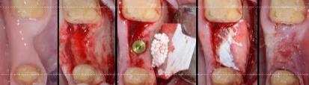
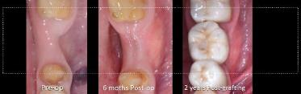
The bone is stable
Randomized Clinical Trial: Non-inferiority established for creos syntogain when compared to Bio-Oss in terms of vertical and horizontal changes.
Measurements were made on CBCT, based on anatomical reference points (sinus floor or mandibular canal)
Clinical cases:
Bone is stable and it maintains the volume of the defect.
(courtesy of Dr Ginebrada)
*Raymond Y, Pastorino D, Ginebreda I, et al. Computed tomography and histological evaluation of xenogenic and biomimetic bone grafts in three-wall alveolar defects in minipigs. Clinical Oral Investigations 2021. https://doi.org/10.1007/s00784-021-03956-y
5/12/2022
14
Notes:
P-value > 0.05
Indicates that There is no difference between two measured phenomena = substantially equivalent each other.
Here we would need:
Photos of clinical cases from Ginebreda With long follow-up (2 years)
Histologies and % measurements of bone to contact to clearly demonstrate osteoconductiviy and volume stability.
Histologies from clinical cases

Slide 15

In addition:
A unique round shape of the granules
  Making it easy to apply in situ
  Avoiding stacking effect.
Scheme representing the packing effect of different granules’
morphologies after vibrations and micromovements
5/12/2022
15

Slide 16

In addition:
High hydrophilicity
  Allowing an easy hydration.
  Easy granule handling.
Average quantity of absorbed water by 3 cc of BGS after stabilisation
5/12/2022
16

Slide 17
In addition:
It is non-sintered
Sintering (frittage)
  = Formation of the granular material (from powder) using heat, without melting it.
  Sintering temperature enables to control microstructural properties : crystallinity, grain size, density, and microporosity.
  Those microstructural properties greatly influence the performance of hydroxyapatite.
  Better bioactivity for hydroxyapatite scaffold can be achieved using a lower temperature manufacturing.
Problem of sintering synthetic hydroxyapatite
→ Reduces micropores (Weibrich et al. 2000) and osteoconductivity (Henkel et al. 2006).
creos™ syntogain is not-sintered
Micropores and osteoconductivity are not reduced.
Better for the bone regeneration.
5/12/2022
17

Slide 18
In addition:
One of the largest Randomized Clinical Trials
Efficacy of MimetikOss in alveolar ridge preservation
before implant placement:
A multicenter Randomized Controlled Trial
      Objective: Non-inferior study comparing the efficacy of MimetikOss against Bio-Oss
      Population: 102 patients randomly separated in two double-blind groups
      Indication: Alveolar preservation followed by implant placement at 6 months with a follow-up of 12 months
      Multicenter study: 8 centers across Spain and Chile
      Authors:
Dr Miguel Roig Cayón
International University of Catalonia
Dr Ángel Fernández Bustillo
Bustillo Clinic
Dr María Peñarrocha Diago
University of Valencia
Dr Renzo Bellini
Dental Triana Clinic
Dr Pablo Galindo Moreno
University of Granada
Dr Antonio Sanz Ruiz
University of los Andes
Dr Eugenio Velasco Ortega
University of Sevilla
Dr Manuel Martín Luque
IOC Clinic Dental
5/12/2022
18

Slide 19
Randomized Clinical Trial - Introduction
Outcomes of the study:
    Primary:
      Vertical and horizontal changes of the ridge 6 months post bone grafting via CBCT analysis
    Secondary:
      Histological and histomorphometrical analysis via a biopsy taken during implant placement visit
      Implant stability evolution via Implant Stability Quotient (ISQ) measurement and bone quantity and quality via visual evaluation (Lekholm & Zarb)
      Vertical change at 4 & 12 months after implant placement via periapical radiographs
Notes:
Implant Stability Quotient
Implant stability quotients (ISQ values) are obtained in dental clinical practice on a non-invasive basis by resonance frequency measurement rapidly after surgical placement of implants. The ISQ-values are used as indicator for mechanical implant stability, and are believed to have predictive power for clinical outcome.
The clinical significance of implant stability quotient (ISQ) measurements: A literature review - PMC (nih.gov)
Visita 6 para fumadores
Cover of the crew
Visit 6 healing abutment for smokers
Visit 4&5 healing abutment for non smokers
Vist 7-9 1 month for healing

Slide 20
Randomized Clinical Trial - Results
Dimensional variation of the alveolar ridge:
  Measurements were made on CBCT, based on anatomical reference points (sinus floor or mandibular canal)
Variable |  | Biomimetic SBG n=42 | Reference DBBM n=41
Bone quantity changes based on CBCT | % change width | -1.78 | -2.16
 | % change height | 1.35 | 2.99
Non inferiority established for creos syntogain when compared to Bio-Oss in terms of vertical and horizontal changes.
Notes:
any negative value means that the dimension decreased (loss of height or width), and any positive value that the dimension increased.
The "ideal alveolar preservation" would have 0% of change (stability in volume).

Slide 21
Randomized Clinical Trial - Results
Implant stability and insertion torque:
  Measured at the time of implant placement, 6 months post-bone grafting
NobelParallelTM CC implant was used
 | syntogain n= 45 | Bio-Oss n= 43 | t-test
Insertion Torque (N.cm⁻¹) | 36.2 | 35.1 | 0.676
StDev | 12.4 | 13.6
ISQ | 70.2 | 70.8 | 0.770
StDev | 12.0 | 9.2
No statistically significant difference was observed when comparing creos syntogain to Bio-Oss
in terms of insertion torque and Implant Stability Quotient

Slide 22
Clinical indications

Slide 23
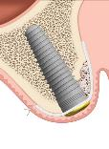
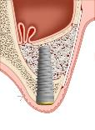
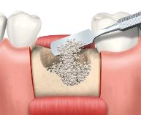
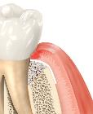
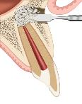
When is creosTM syntogain used?
Implant placement
Sinus augmentation
Extraction socket management
Further indications may include:
Vertical & horizontal ridge augmentation
Bone dehiscences and fenestrations around implants
Periodontal defects
Apicoectomy
5/12/2022
23
Notes:
Creos syntogain is used when you have a deficit of bone, meaning when there is no sufficient bone to insert a stable dental implant.
The clinical indication is named « Guided Bone Regeneration » (GBR).
It is important here to understand that bone graft is really often necessary for implant placement: 40-60% of all implant treatments need biomaterials.
IFU syntogain:
Augmentation or reconstruction treatment of the alveolar ridge.
Filling of infrabony periodontal defects.
Filling of defects after root resection, apicoectomy and cystectomy.
Filling of extraction sockets to enhance preservation of the alveolar ridge.
Elevation of periodontal defects in conjunction with products intended for Guided Tissue Regeneration (GTR) and Guided Bone Regeneration (GBR).
Filling of peri-implant defects in conjunction with products intended for Guided Bone Regeneration (GBR).
creos™ syntogain is intended to be placed in bony voids or gaps that do not alter the stability of the bony structure.

Slide 24
GMT79827 © Nobel Biocare Services AG, 2022 All rights reserved.
Disclaimer: Nobel Biocare, the Nobel Biocare logotype and all other trademarks are, if nothing else is stated or is evident from the context in a certain case, trademarks of Nobel Biocare. Please refer to nobelbiocare.com/trademarks for more information.
Product images are not necessarily to scale. All product images are for illustration purposes only and may not be an exact representation of the product.
Please contact the local Nobel Biocare sales office for current product assortment and availability. Disclaimer: For prescription use only. Caution: Federal (United States) law or the law in your jurisdiction may restrict this device to sale by or on the order of a dentist or a physician. See Instructions For Use for full prescribing information, including indications, contraindications, warnings and precautions
MimetikOss™ has been distributed as creos™ syntogain since October 2022. Legal Manufacturer: Mimetis Biomaterials S.L., Carrer de Cartagena, 245, 3E, Barcelona 08025, Spain and distributed by Nobel Biocare Services AG.

