Slide 1
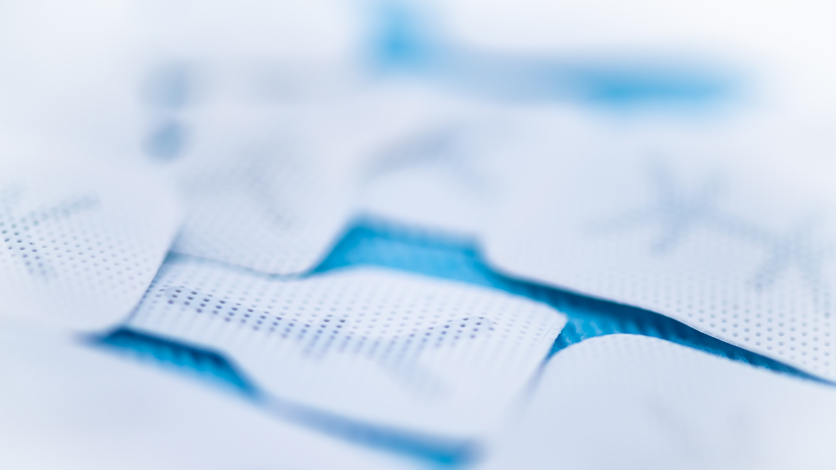
creosTM syntoprotect

Slide 2
creos™ biomaterials
a comprehensive portfolio
for soft tissue & bone regeneration
Matrix
creos™ mucogain
Bone Graft Substitutes
creos™ xenogain
Membranes
creos™ xenoprotect
creos™ syntoprotect
2
Notes:
US version

Slide 3
creosTM syntoprotect
Your easy choice of dense PTFE membranes to expand grafting options
3

Slide 4
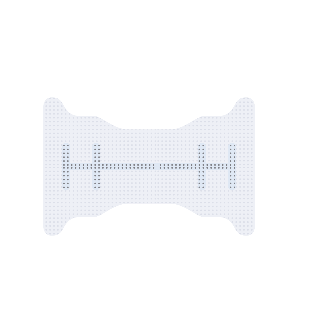
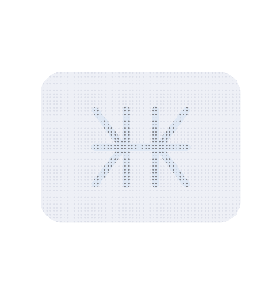
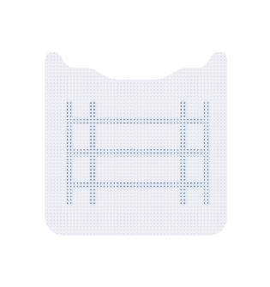
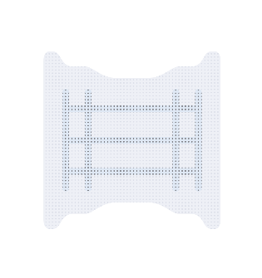
creosTM syntoprotect product range
comprises two product types
creosTM syntoprotect
PTFE membranes
creosTM syntoprotect
Ti-reinforced PTFE membranes
Ideal dental membrane for socket grafting and grafting where primary closure is not possible
Ideal membrane for ridge augmentation and grafting bony defects missing one or more wall

Slide 5
What is PTFE*?
(the material from which creos syntoprotect is made)
*polytetrafluoroethylene
PTFE is a synthetic polymer that is non-resorbable, biologically inert and chemically non-reactive, and therefore an ideal material for many medical device applications.
Colloquially, PTFE-based materials are often referred to by the trade name Teflon from DuPont
In addition to its long history in the field of guided bone regeneration (GBR), PTFE has been used for over 30 years in cardiovascular applications such as suture, vascular grafts and heart valves.

Slide 6
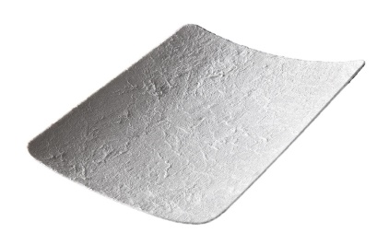
How does creosTM syntoprotect fit into our barrier membrane portfolio?
creosTM syntoprotect
Ti-reinforced PTFE membrane
creosTM syntoprotect
PTFE membrane
creos xenoprotect
Extraction sockets
Extraction sockets
Fenestrations/Dehiscences
Sinus lifts
Small to large defects not requiring structural support
Large defects requiring structural support
(e.g. ridge augmentations)
open
technique
closed technique
GBR spectrum
For indications between open extraction socket grafting and ridge augmentations we recommend creosTM xenoprotect (resorbable membrane) as barrier membrane.
Notes:
IFU

Slide 7
creosTM syntoprotect product family comprises two product types
creosTM syntoprotect
PTFE membranes
The following slides will highlight the application and benefits of the non-reinforced version
Ideal dental membrane for socket grafting and grafting where primary closure is not possible

Slide 8
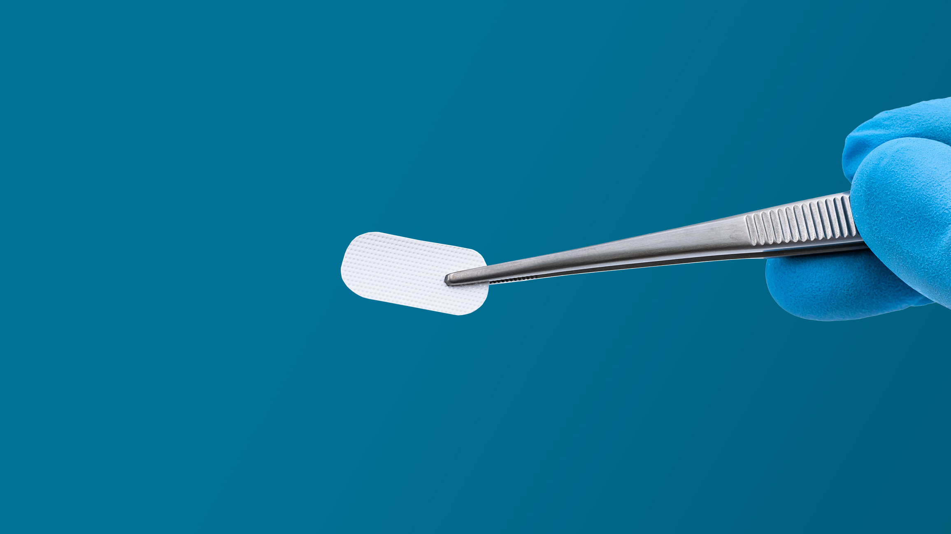
creosTM syntoprotect PTFE membranes
Designed specifically for extraction site grafting and augmentation procedures where exposure to the oral cavity is common

Slide 9
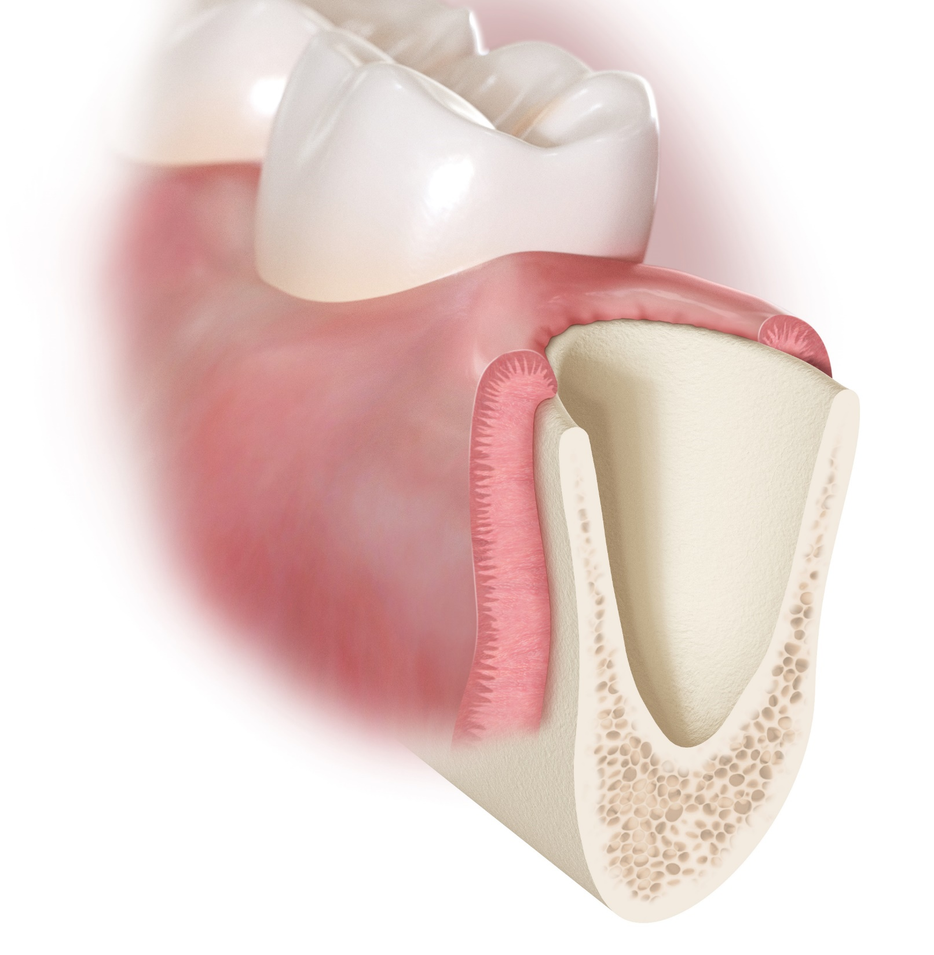
How is the creosTM syntoprotect PTFE membrane used for extraction socket grafting?
T=0, Tooth Removed

Slide 10
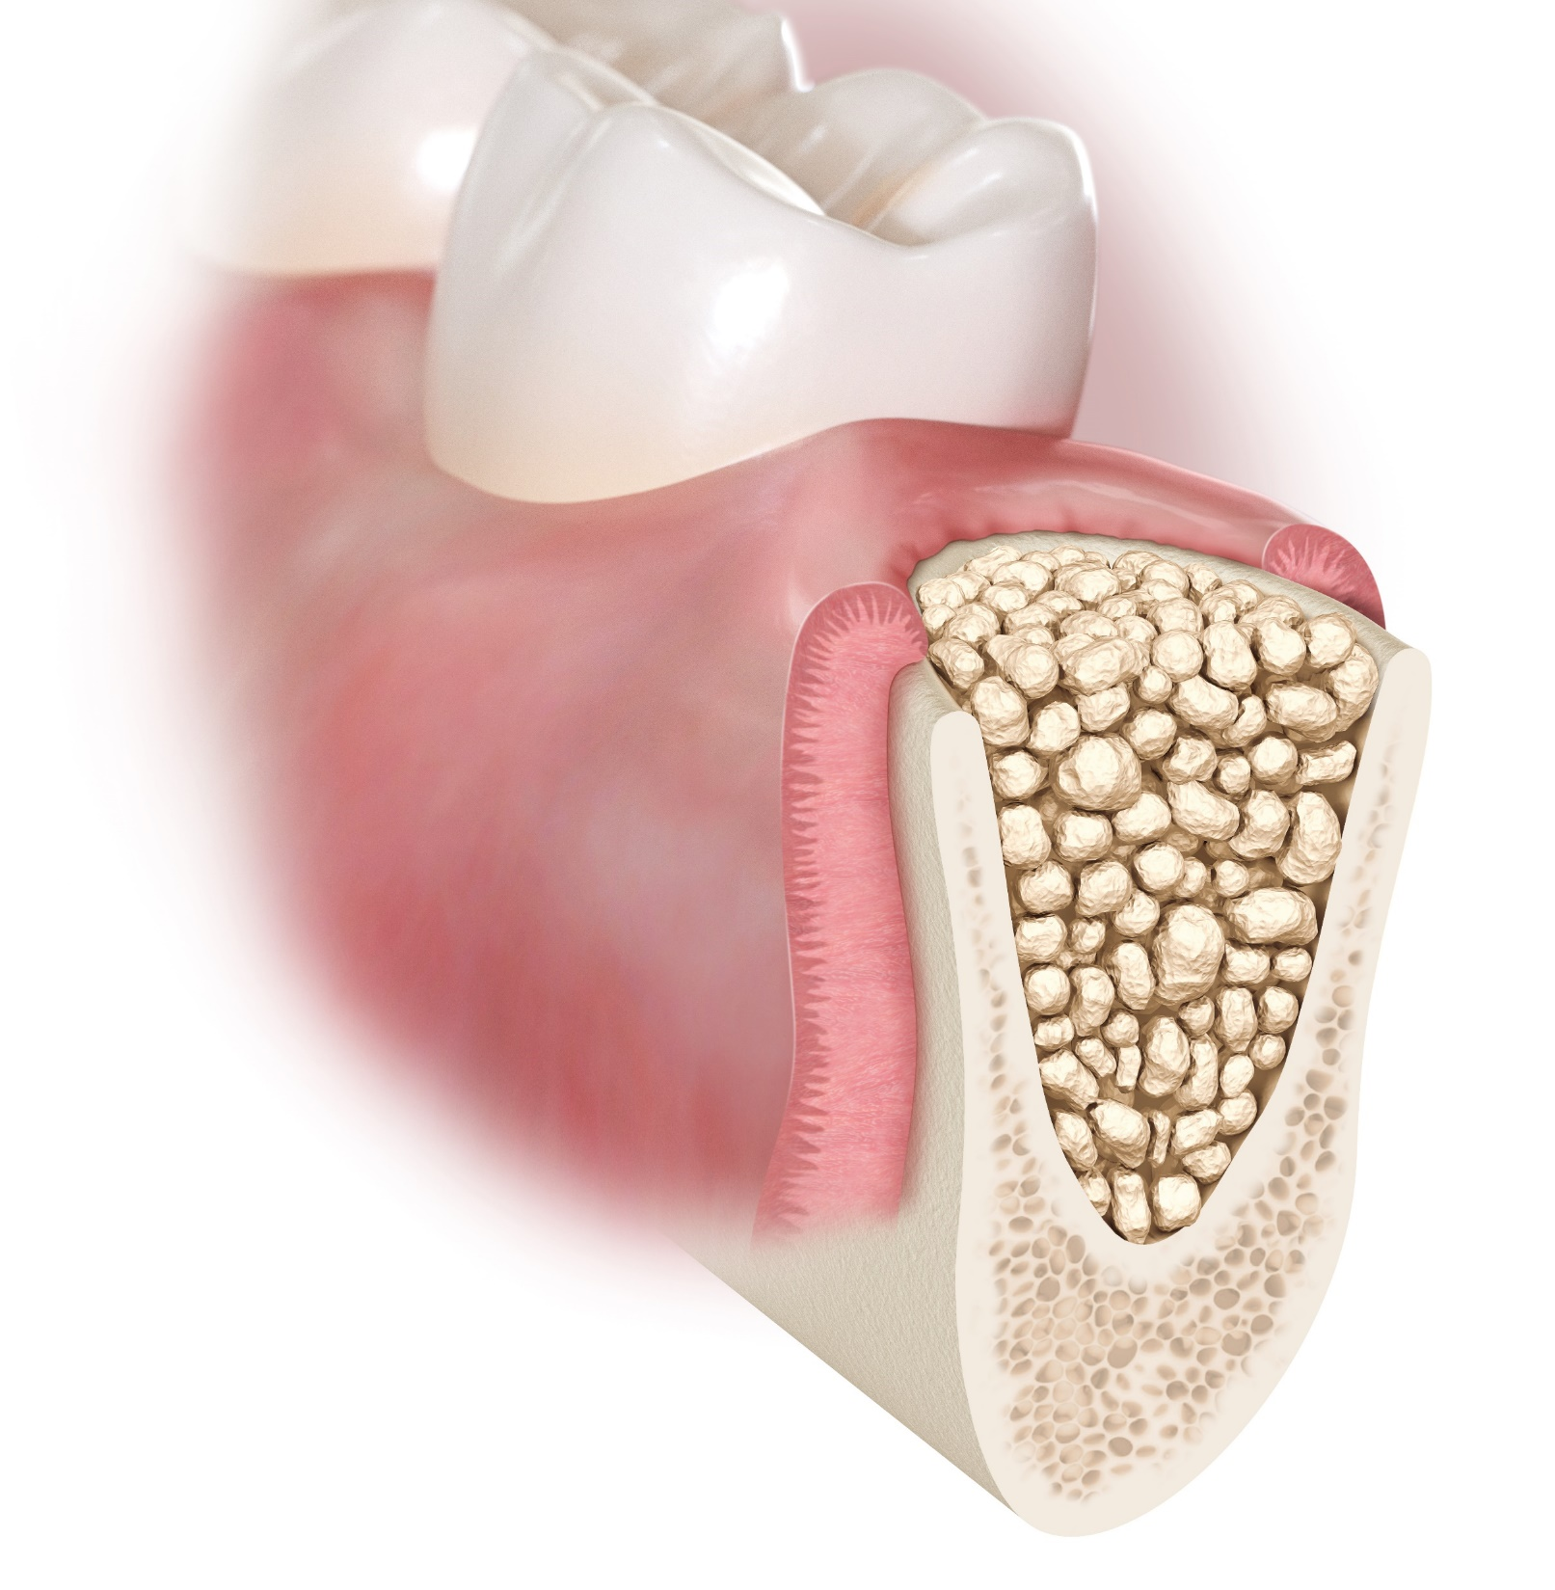
T=0, bone graft placed

Slide 11
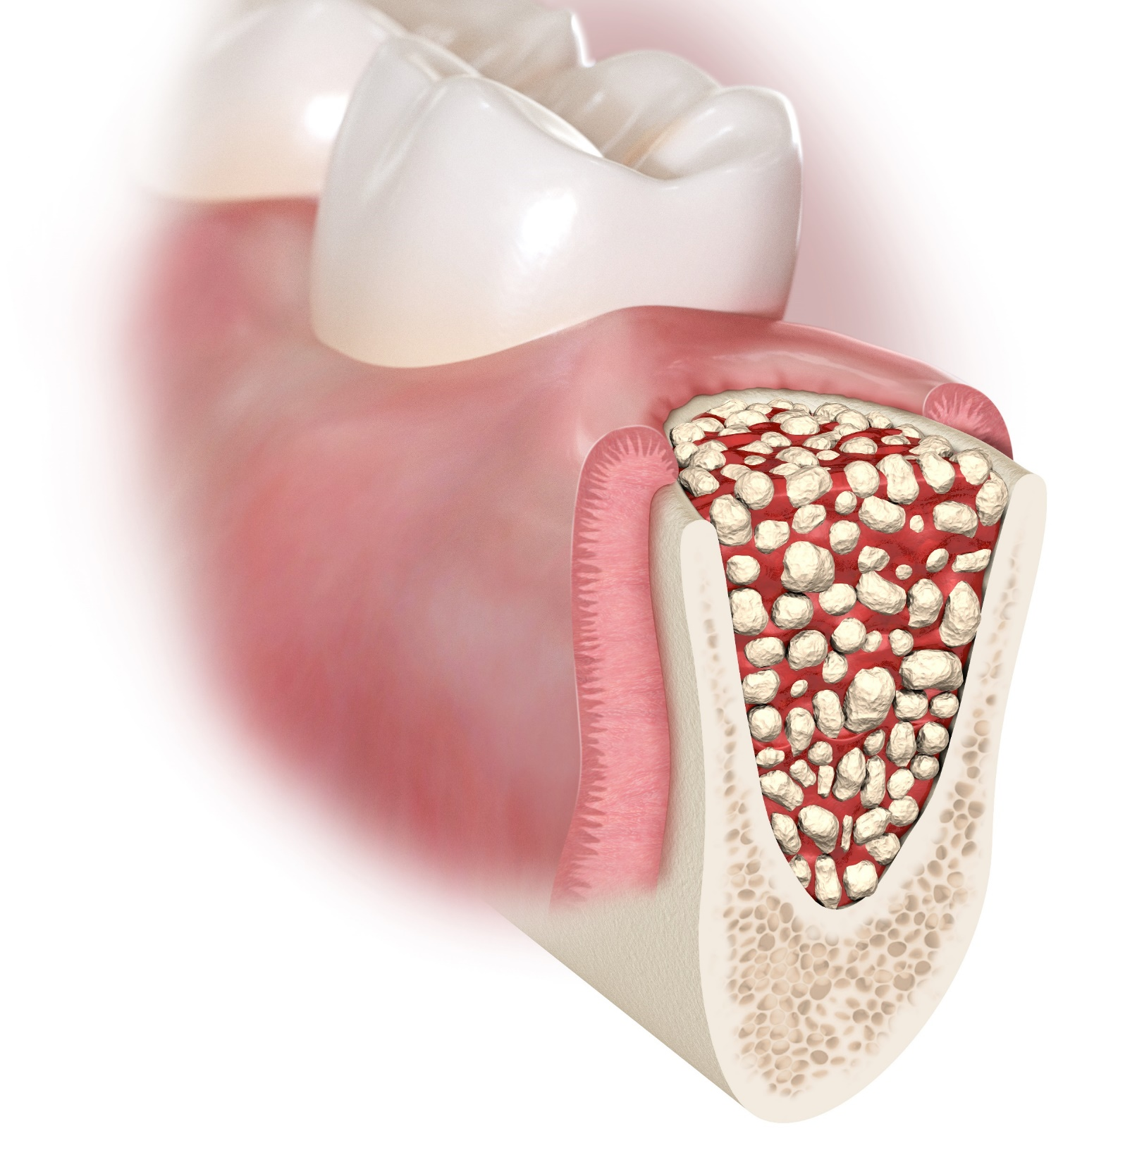
T=0, bone graft placed

Slide 12
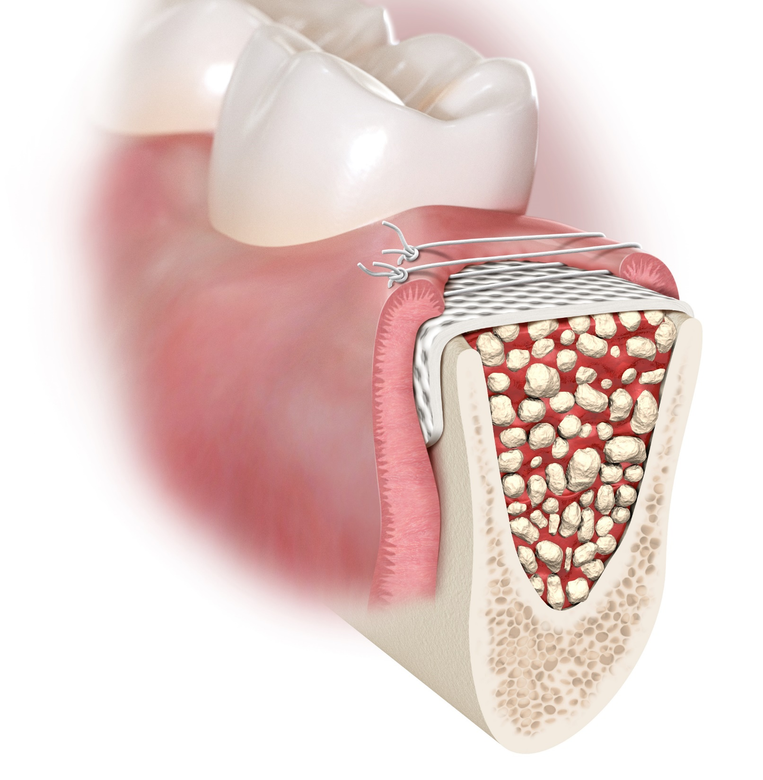
The membrane should be trimmed to remain at least 1 mm from adjacent, uninvolved teeth.
The membrane should be trimmed to extend 3-4 mm beyond the defect margins to provide adequate
protection of the bone defect and enhance membrane stability.
T=0, creos syntoprotect and non-resorbable sutures placed

Slide 13
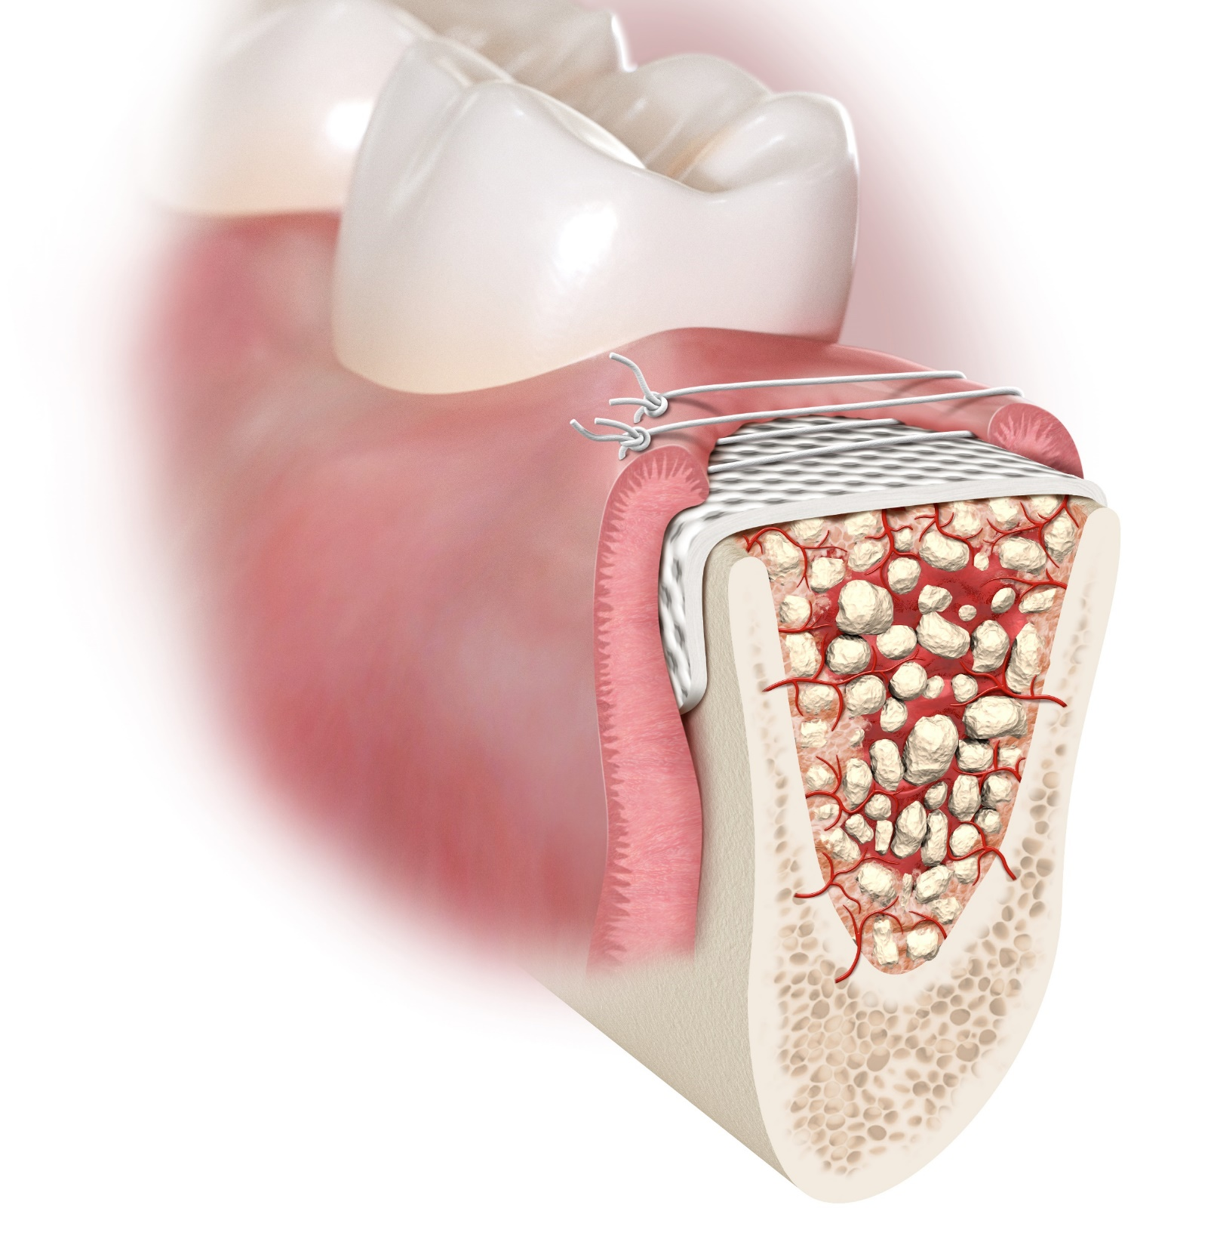
For
best results when using textured material, place dimples side up towards gingival tissue.
After trimming, there should be no sharp corners or rough edges.
T= 2 weeks post-op, suture removal

Slide 14
T= 2 weeks post-op, suture removal

Slide 15
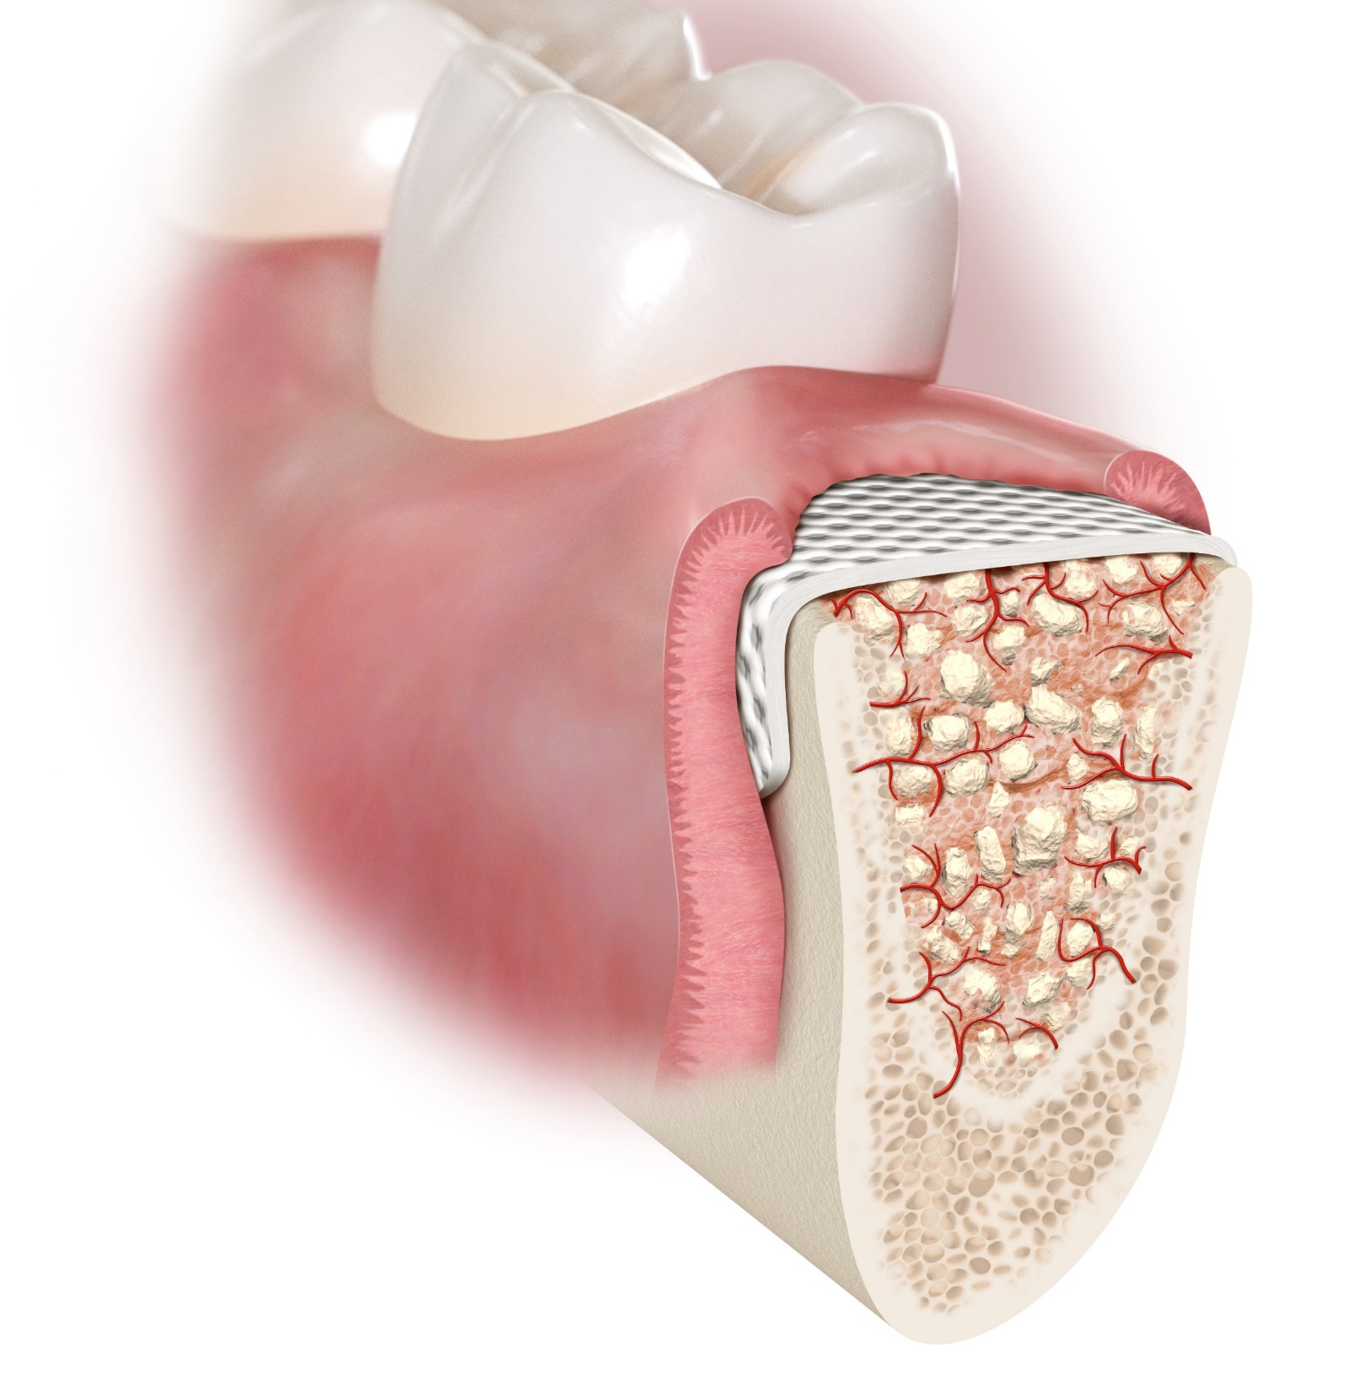
The membrane is not intended to remain in place as a permanent implant and should therefore be removed following
the bone regeneration procedure.
T= 4 weeks post-op, membrane removal

Slide 16
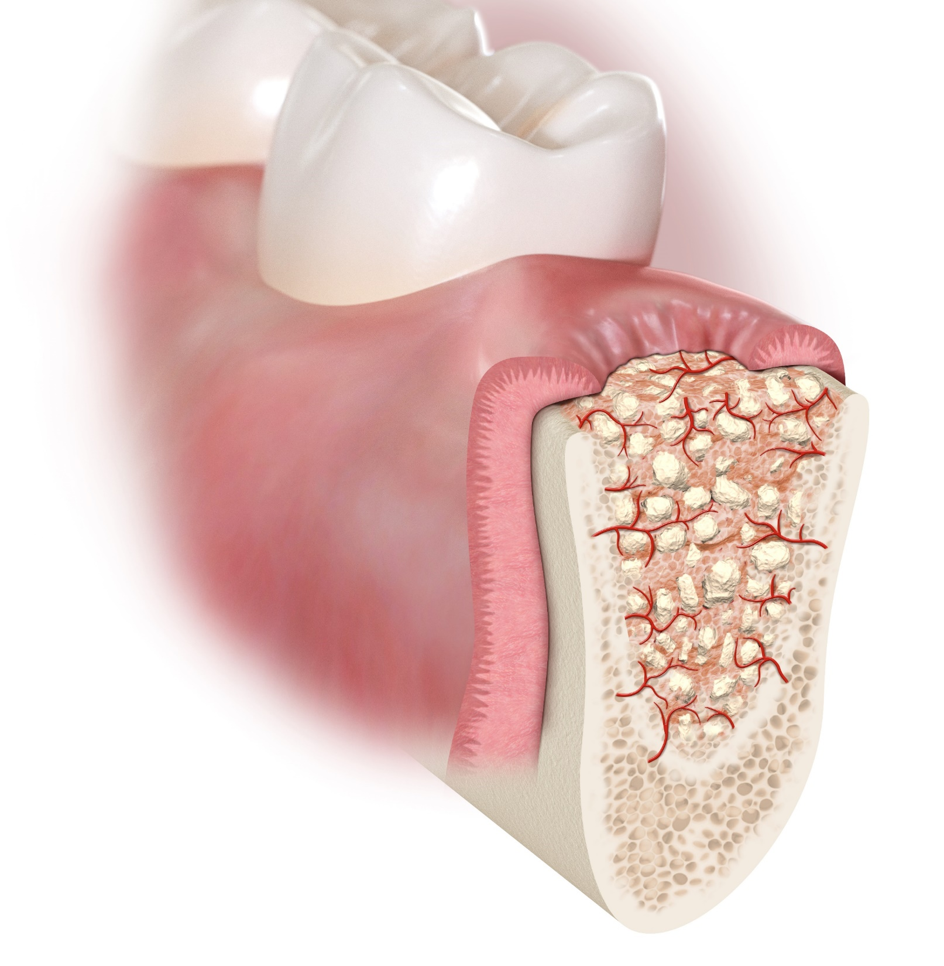
When removal is desired, the
membrane may be easily removed, if exposed, by grasping with forceps and gently removing it from the tissue.
T= 4 weeks post-op, membrane removal

Slide 17
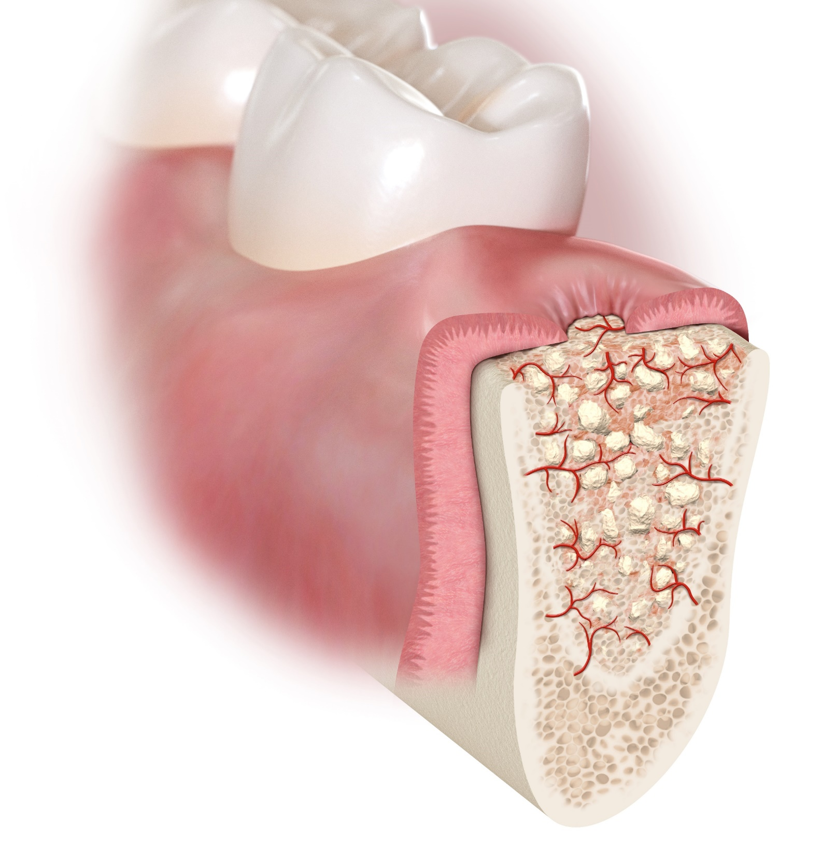
T= 5 weeks post-op, soft tissue granulating over osteoid

Slide 18
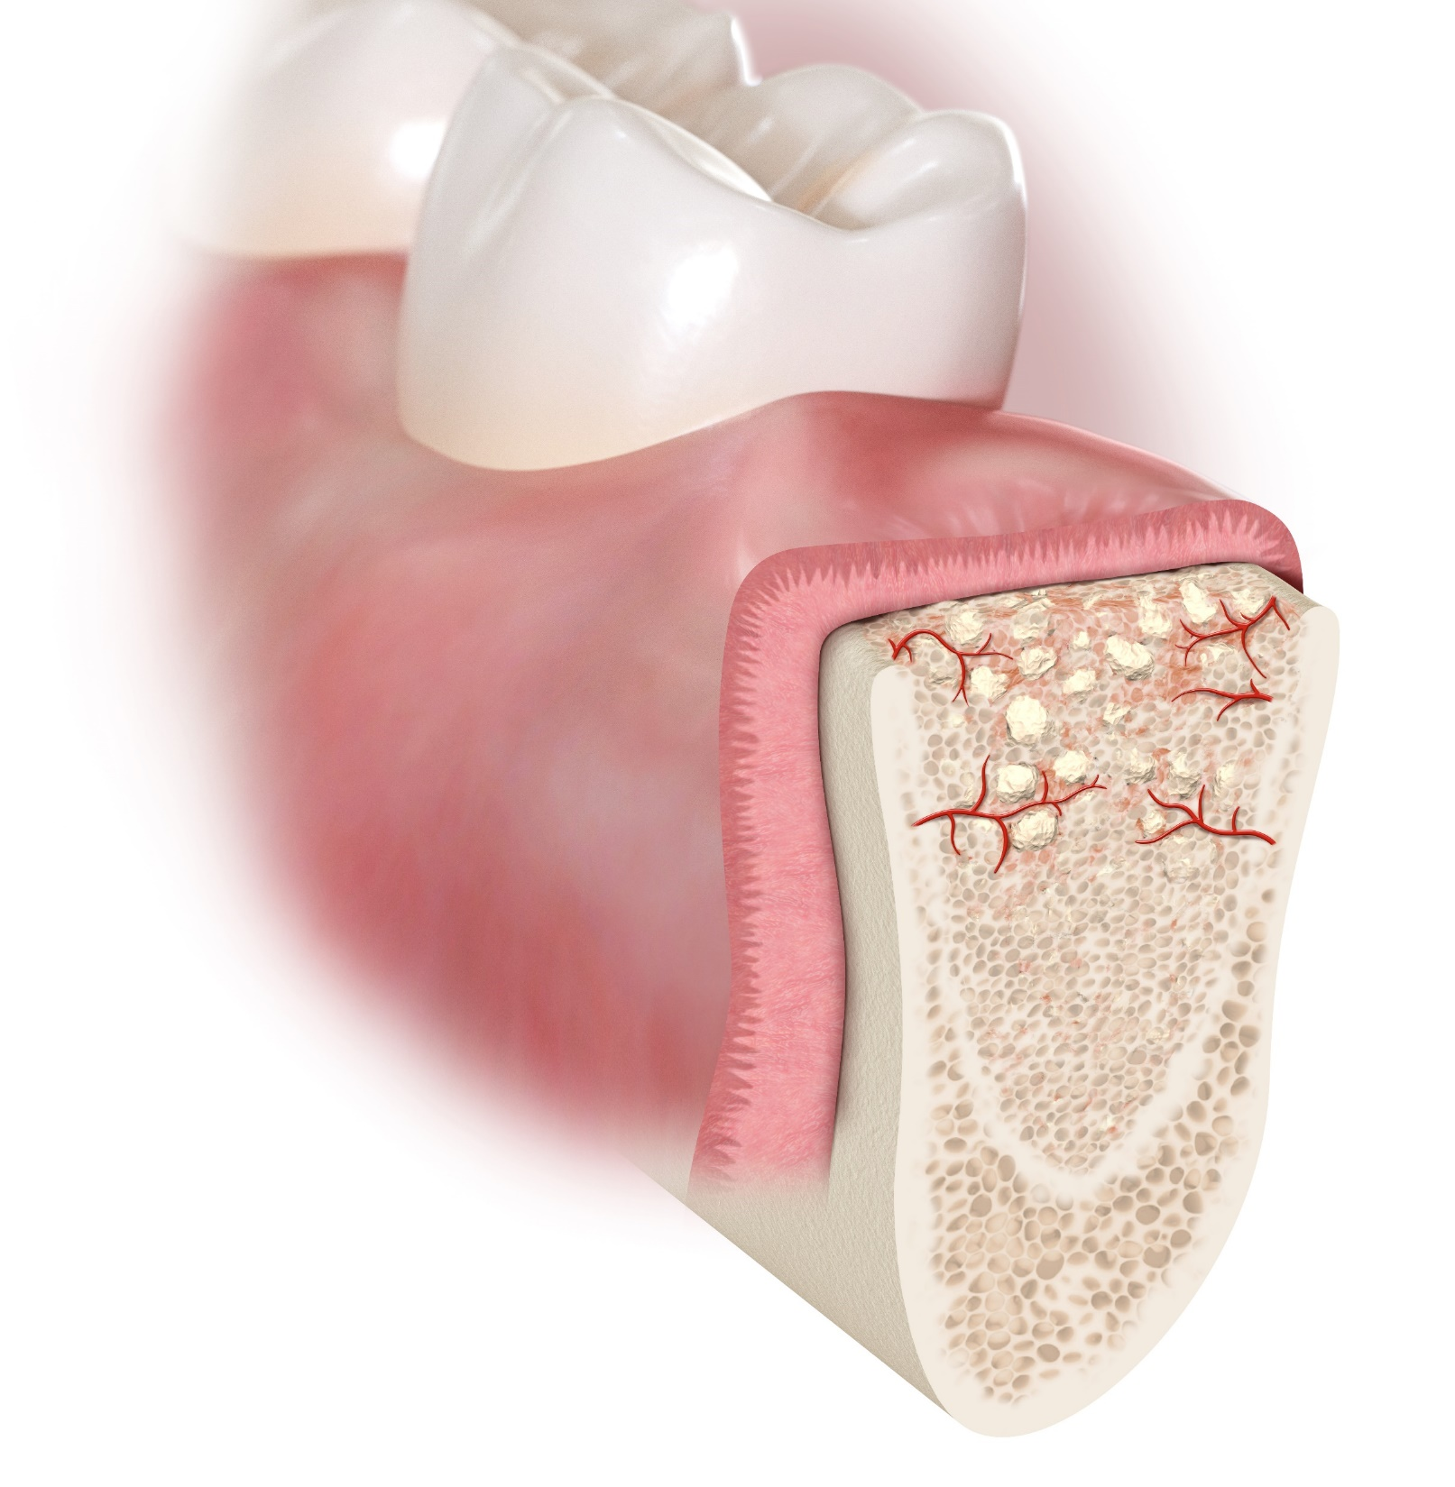
T= 6-7 weeks post-op, soft tissue completely healed over osteoid

Slide 19
1. Purposely leave the membrane exposed
Preservation of the soft tissue architecture and keratinized mucosa
2. 100% dense (non-expanded) PTFE
Impervious to bacteria (pore size less than 0.3 µm)
3. Soft tissue attaches, but doesn’t grow through the membrane
Exposed membrane allows for non-surgical removal; no anesthesia required
Why creosTM syntoprotect PTFE membrane?
19

Slide 20
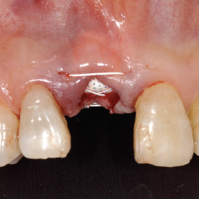
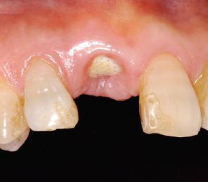
1. Purposely leave the membrane exposed
Preservation of the soft tissue architecture and keratinized mucosa
The primary advantage of dense PTFE is the ability to remain exposed in the mouth while protecting the underlying defect and bone graft.
Soft tissue architecture is maintained (can be left in its native position), including the interdental papilla and the full width of keratinized mucosa.
A second surgery is not required for membrane removal. Membrane removal is accomplished by grasping the exposed membrane with forceps and gently lifting it from the wound.
T=0
T=3 weeks
Preserved mucogingival line
© 2008 Osteogenics Biomedical, Inc. BBFY0607
20

Slide 21
2. 100% dense (non-expanded) PTFE
Impervious to bacteria (pore size less than 0.3 µm)
PTFE as a biomaterial differs in porosity based on the amount of expansion applied during manufacturing.
Dense PTFE
creosTM syntoprotect
Expanded PTFE
First Generation PTFE (e.g. GoreTex®)
50 µm
50 µm
Pore size < 0.3 microns
Pore size 30-100 microns
Dense PTFE is manufactured to eliminate expansion of the nodes and fibrils, resulting in a micro-porous material that is impervious to bacteria while still allowing diffusion of gases and small molecules. the diameter of pathogenic bacteria generally less than 10 μm.
21
Notes:
PTFE is bioinert and does not cause inflammation.
The membrane is soft, flexible and easy to handle.

Slide 22
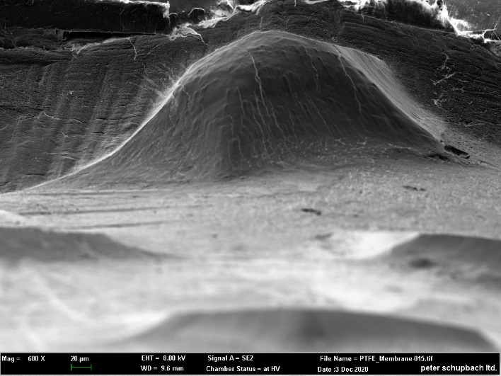
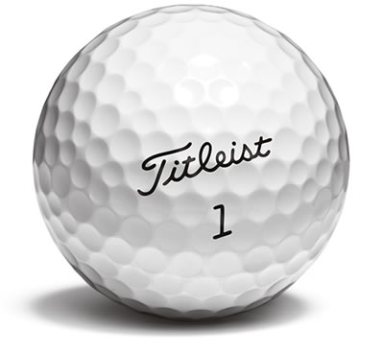
3. Soft tissue attaches, but doesn’t grow through the membrane
Exposed membrane allows for non-surgical removal; no anesthesia required
Hexagonal surface dimples (like on a golf ball) provide a textured surface that increases the area available for cellular attachment without increasing porosity.
The increased stability in the wound results in less flap retraction and reduces the risk of membrane movement and loosening.
Removal of dense PTFE is simplified due to the lack of tissue ingrowth into the surface structure.
Surface dimples
100 µm
500 µm
Cross-section of surface dimple
22
SEM Image courtesy of Schupbach Ltd

Slide 23
1. Predictability
Clinical evidence
Over 30 clinical publications available
1. Barboza EP et al. Implant Dent. 2010;19:2-7.
2. Hoffman O et al. J Periodontol 2008;79:1355-1369.
3. Fotek PD, Neiva RF, Wang HL J Periodontol 2009;80:776-785.
4. Barboza EP, Francisco BS, Ferreira VF. Annual Meeting of the American Academy of Periodontology (AAP) in Seattle, WA, September 6-9, 2008.
In two separate studies treating a total of 696 extraction sites using dense PTFE membranes in an exposed technique, there were no reported infections.^{1, 2}
2. Efficacy
Non-expanded PTFE membrane utilized over extraction sockets, without primary closure, can be predictably used to promote soft tissue enhancement.⁴
(90 days post extraction)
Minimal ridge alterations are observed.³
(1 year post extraction)
Vertical bone loss measured at crest. Horizontal measured from stent to buccal plate.
Measured as reduction of the occlusal distance between buccal and lingual gingival margins
23

Slide 24
Extraction and Ridge Preservation Followed by Delayed Implant Placement of a Second Mandibular Molar with Proximity to the Inferior Alveolar Nerve
Link to the case series
Selected open access case series
24

Slide 25
Article list

Slide 26
creosTM syntoprotect product family comprises two product lines
creosTM syntoprotect
Ti-reinforced PTFE membranes
The following slides will highlight the application and benefits of the Titanium-reinforced version
Ideal membrane for ridge augmentation and grafting bony defects missing one or more wall

Slide 27
The titanium framework provides additional stiffness in the center portion of the membrane while allowing the edges to remain soft and supple. This feature greatly increases membrane rigidity to aid in spacemaking for the repair of larger defects and defects missing adequate bony architecture.
creosTM syntoprotect Ti-reinforced PTFE membranes
CONFIDENTIAL – INTERNAL USE ONLY

Slide 28
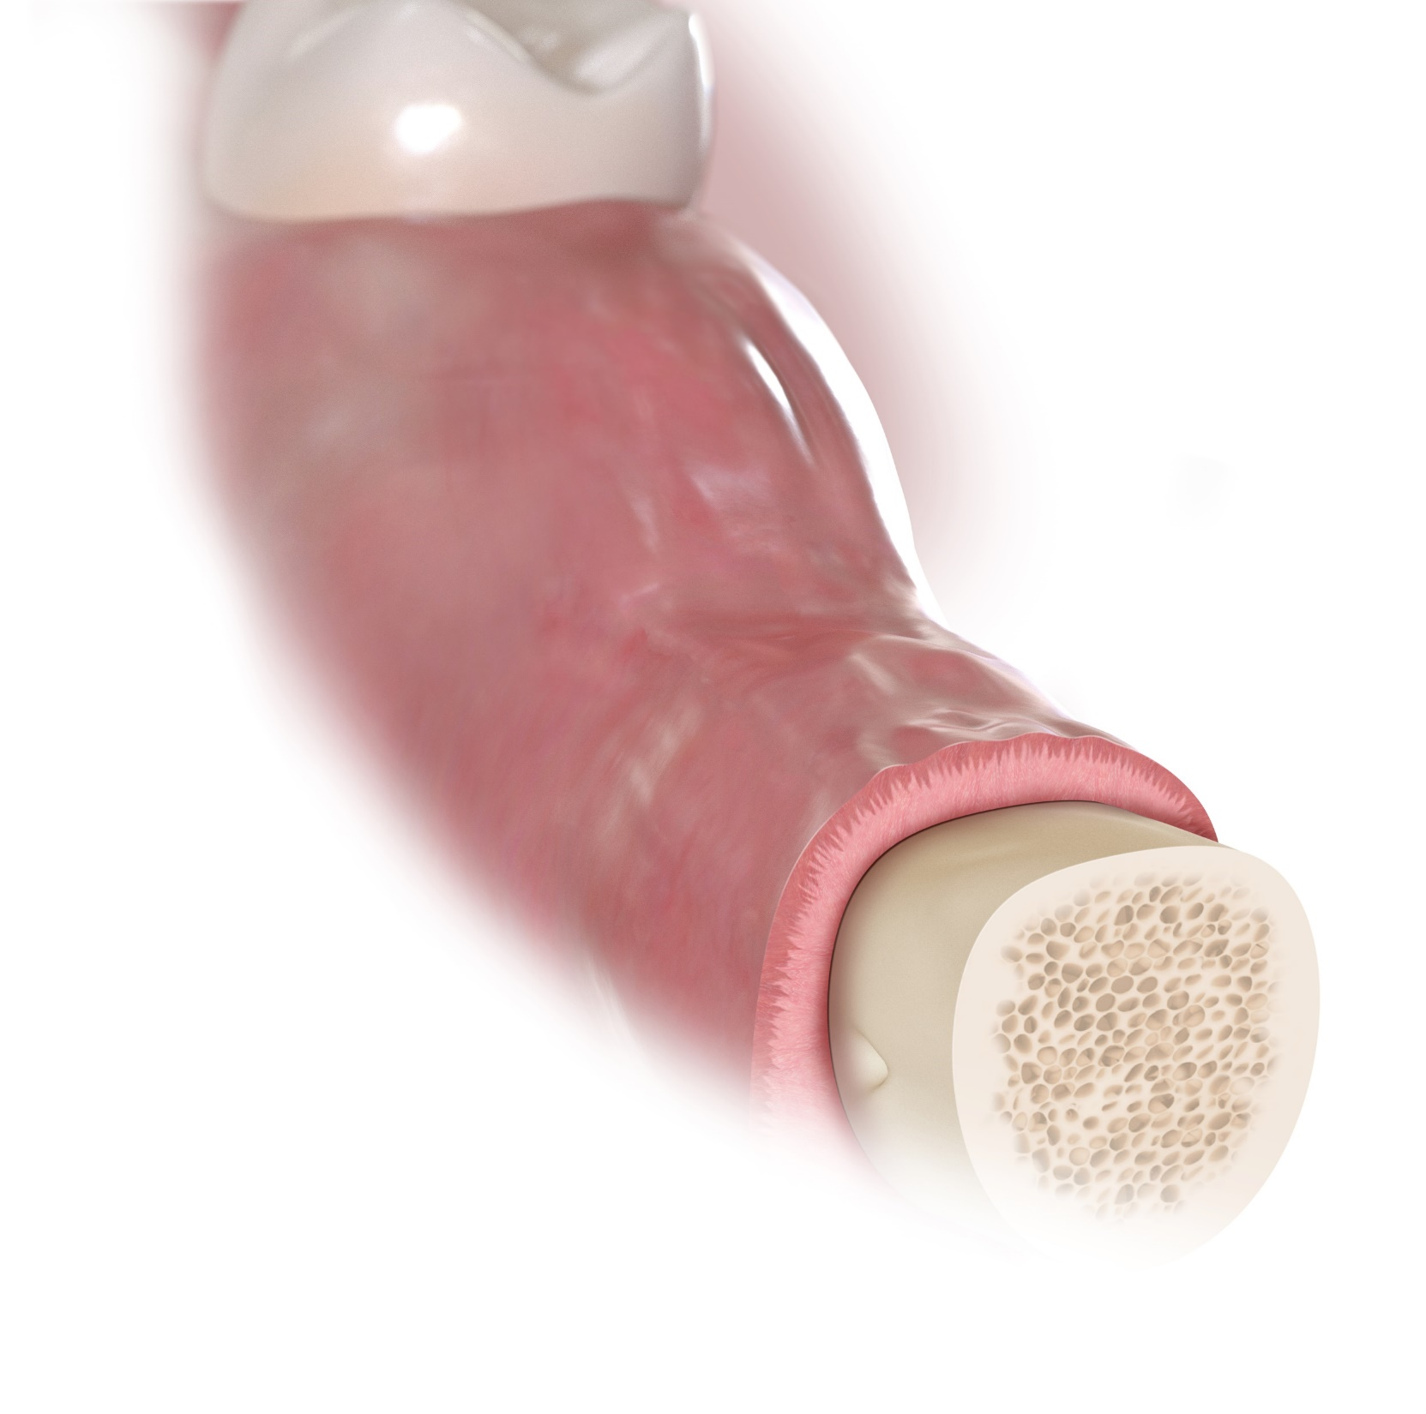
How is the creosTM syntoprotect Ti-reinforced PTFE membrane used for grafting of large bony defects?
T=0, large defect in mandible

Slide 29
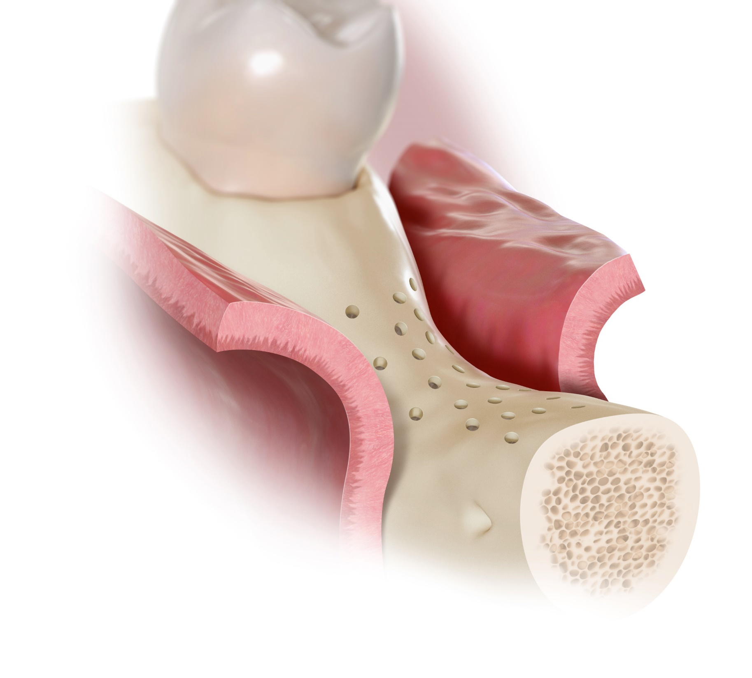
Adequate flap release must be accomplished in order to achieve a tension-free closure if primary closure is desired.
The membrane should be trimmed
to remain at least 1 mm from adjacent, uninvolved teeth.
T=0, Defect uncovered with crestal and vertical incisions:
Host bone has been de-corticated

Slide 30
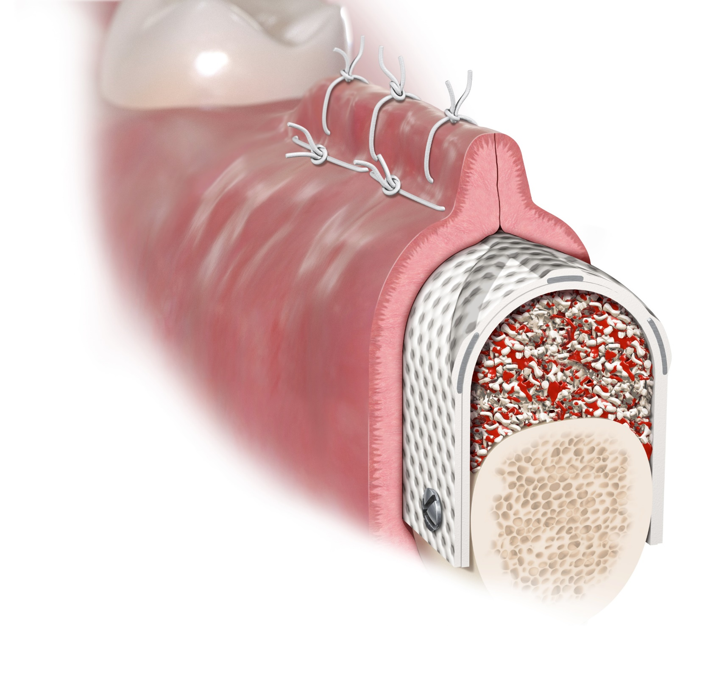
A double layer closure, with a deep
layer of horizontal mattress sutures followed by a standard wound closure with interrupted sutures, is recommended
The use of a
non-resorbable monofilament suture is recommended by the manufacturer.
T=0, mixture of xenogenic bone graft and autologous bone placed under syntoprotect Ti-reinforced membrane
Membrane fixed with fixation screws.
Dual layer closure achieved PTFE Suture
For best results with textured material, place dimples side up towards gingival tissue.

Slide 31
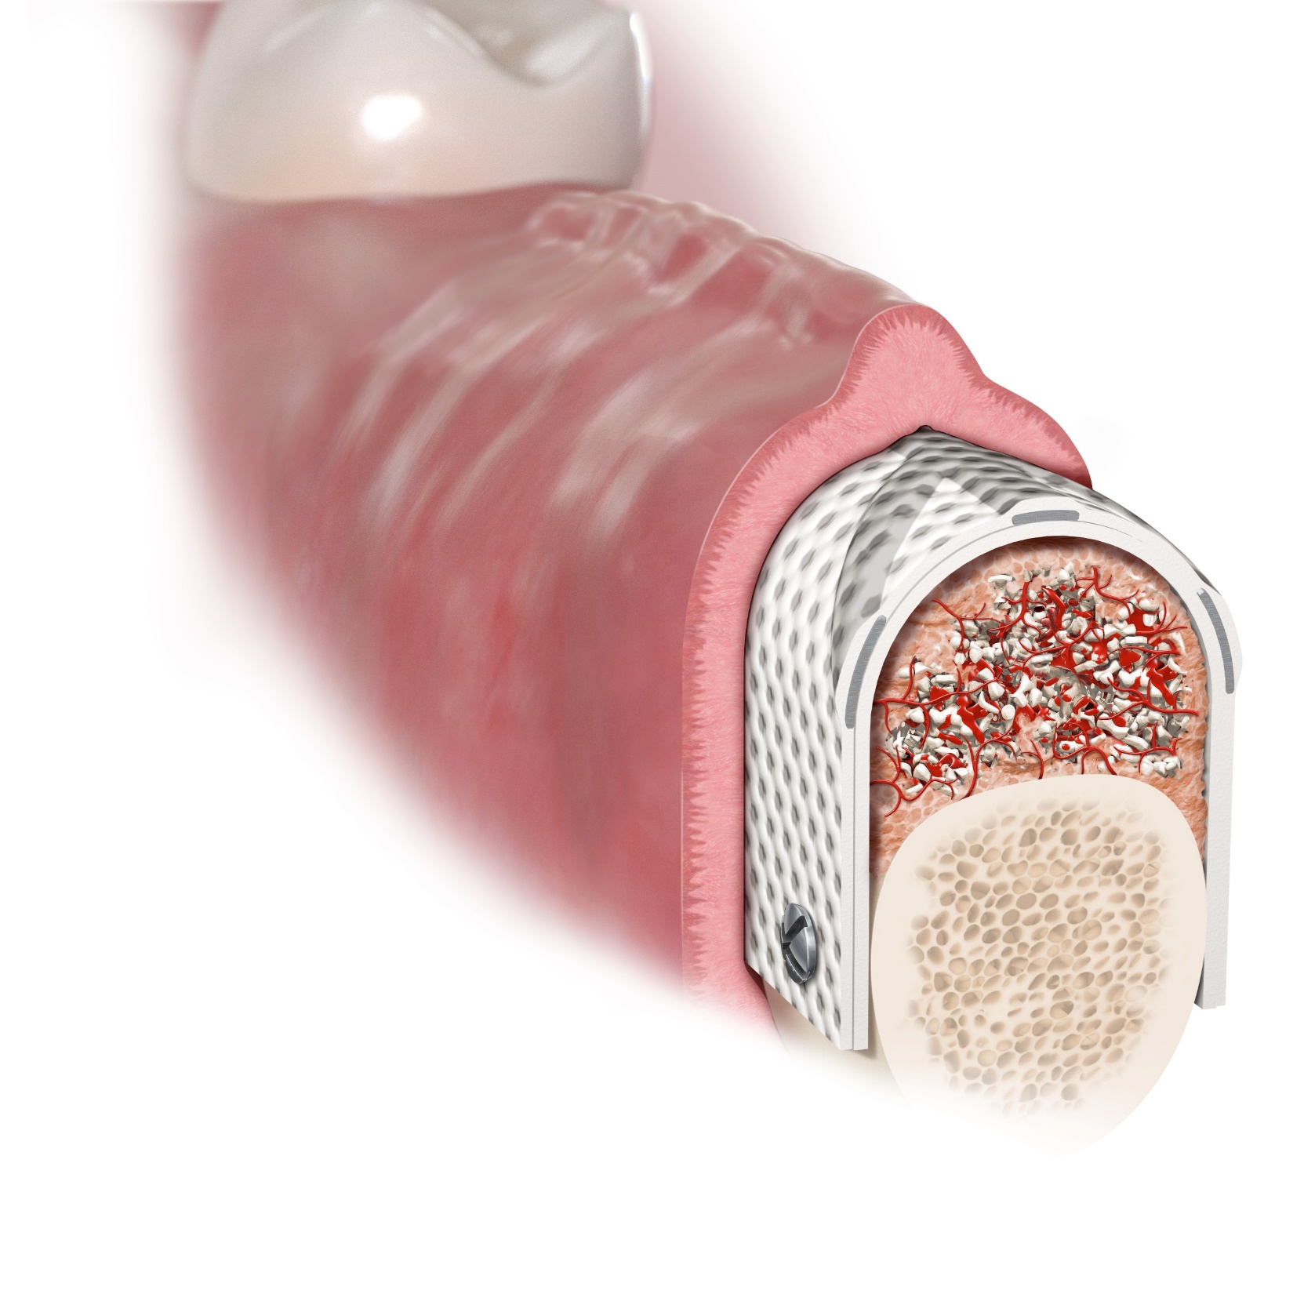
T=2-3 months, Sutures were removed at 14 days, incision line is healing and graft material is consolidating
The membrane may be stabilized with sutures, surgical tacks or screws.

Slide 32
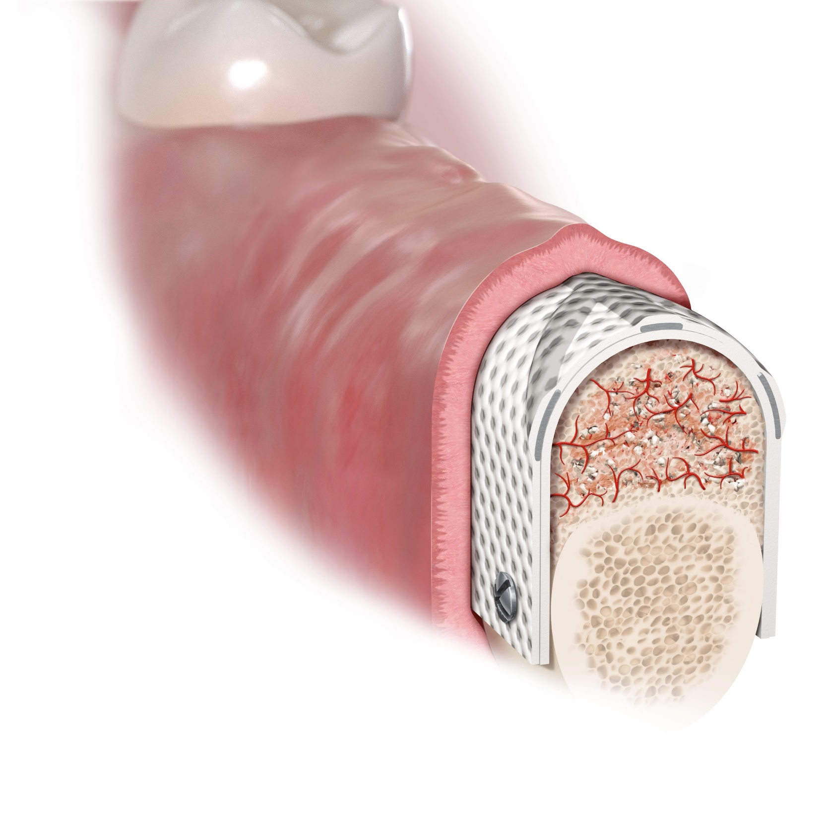
The membrane is not intended to remain in place as a permanent implant and should therefore be removed following
the bone regeneration procedure.
T= 6-9 months, Graft almost completely consolidated, few residual graft particles still visible. Incision line still slightly everted, but completely healed.

Slide 33
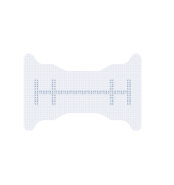
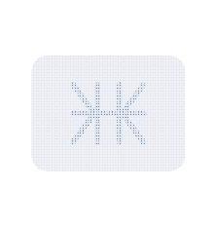
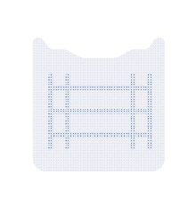
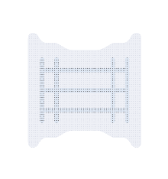
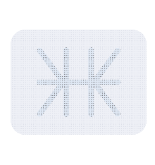
1. Delicate, lightweight framework
Easy to trim and compliant with the overlying soft tissues
2. Less is more
Less titanium bulk allows for greater versatility in shaping and placement, providing additional stability in large, non-spacemaking osseous defects
3. Traditional frame design
Incorporating delicate and strategically placed titanium “struts” with more than 25 years of clinical history and successful use in GBR
4. Handling options
Broad portfolio with 13 shapes in 2 thicknesses
Why creosTM syntoprotect Ti-reinforced PTFE membrane?
33

Slide 34
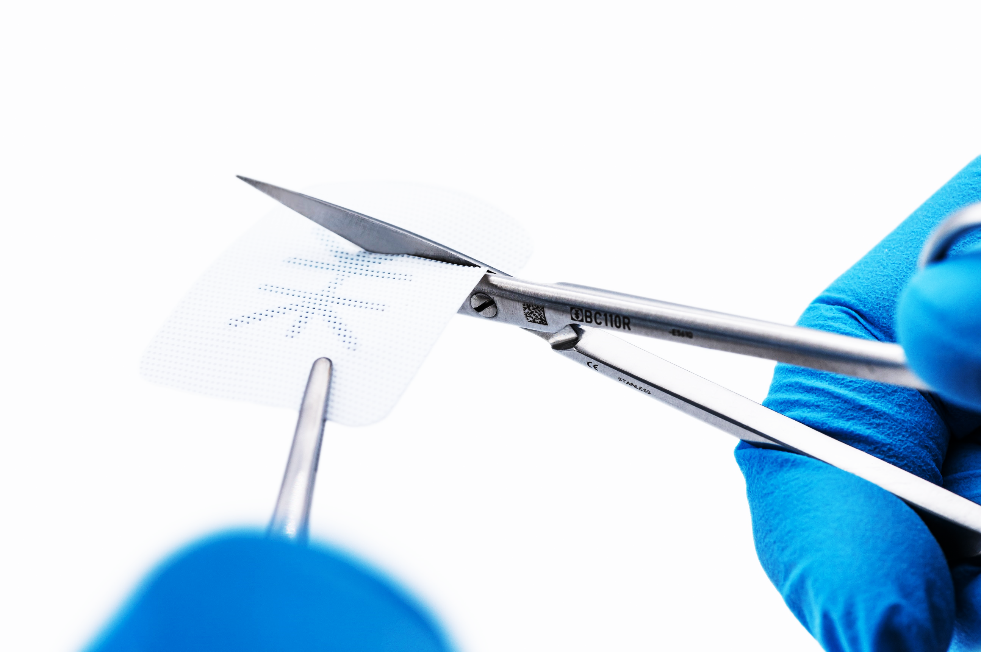
Easy to trim and compliant with the overlying soft tissues
1. Delicate, lightweight framework
The material, including the titanium strut, may be easily cut with surgical scissors. However, with 13 different membrane configurations, aggressive trimming of the membrane is not necessary.
34
Property of Nobel Biocare

Slide 35
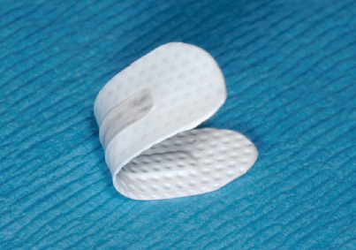
Less titanium bulk allows for greater versatility in shaping and placement, providing additional stability in large, non-spacemaking osseous defects
2. Less is more
The titanium framework is a grade of titanium that has little to no memory. Once formed, the titanium-reinforced membrane will remain in that shape until mechanically altered.
cross-section
Dense PTFE
Titanium
SEM Image courtesy of Schupbach Ltd
Dense PTFE
Titanium
cross-section
CONFIDENTIAL – INTERNAL USE ONLY
35
Property of Nobel Biocare

Slide 36
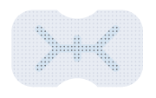
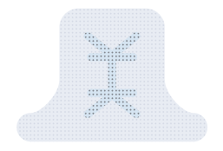
Broad portfolio with 13 shapes in 2 thicknesses
3. Handling options
Versatile rectangular shapes These configurations can be trimmed to fit a variety of defects
e.g. shape 4
Interproximal shapes These configurations are designed to fit between existing teeth
e.g. shape 2
e.g. shape 5
Shapes with fixation points These configurations are designed with fixation points outside of the defect area
All available with a thickness of 150 microns and 250 microns
36

Slide 37
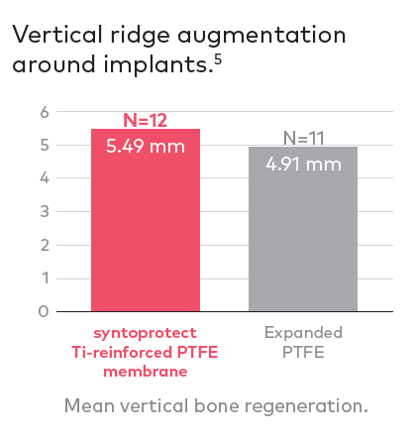
Traditional frame design
Incorporating delicate and strategically-placed titanium “struts” with more than 25 years of clinical history and successful use in GBR
Clinical evidence
More than 20 clinical publications
Easier removal than with more porous titanium mesh and e-PTFE membranes
d-PTFE and e-PTFE membranes showed identical clinical results in the treatment of vertical bone defects around implants, using the GBR technique.⁵
5. Ronda M, Rebaudi A, Torelli L, Stacchi C. Clin. Oral Impl. Res. 2014 Jul;25(7):859-66.
37

Slide 38
Selected open access case series
Ridge preservation/restoration using d-PTFE membranes
Link to the case series
50 µm
50 µm
Management of the exposure of a dense PTFE (d-PTFE) membrane in guided bone regeneration (GBR): A case report
Link to the case series
38

Slide 39
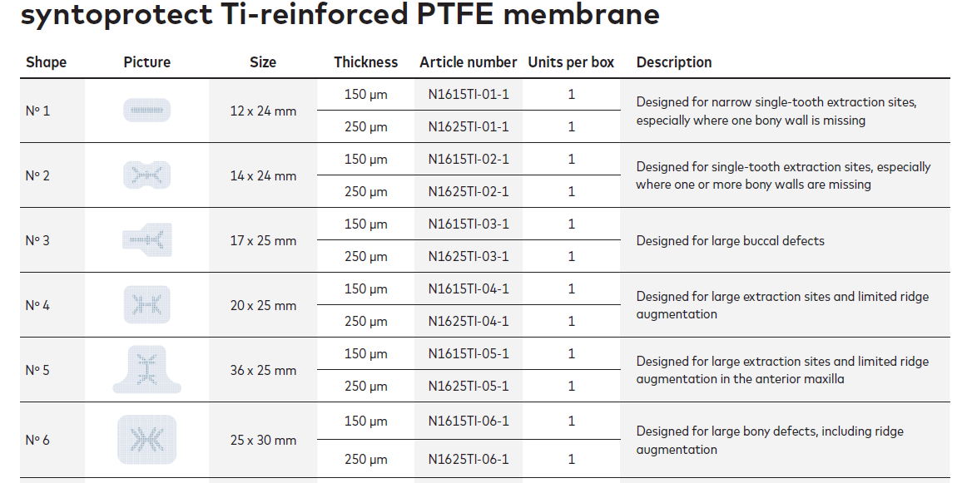
Article list

Slide 40
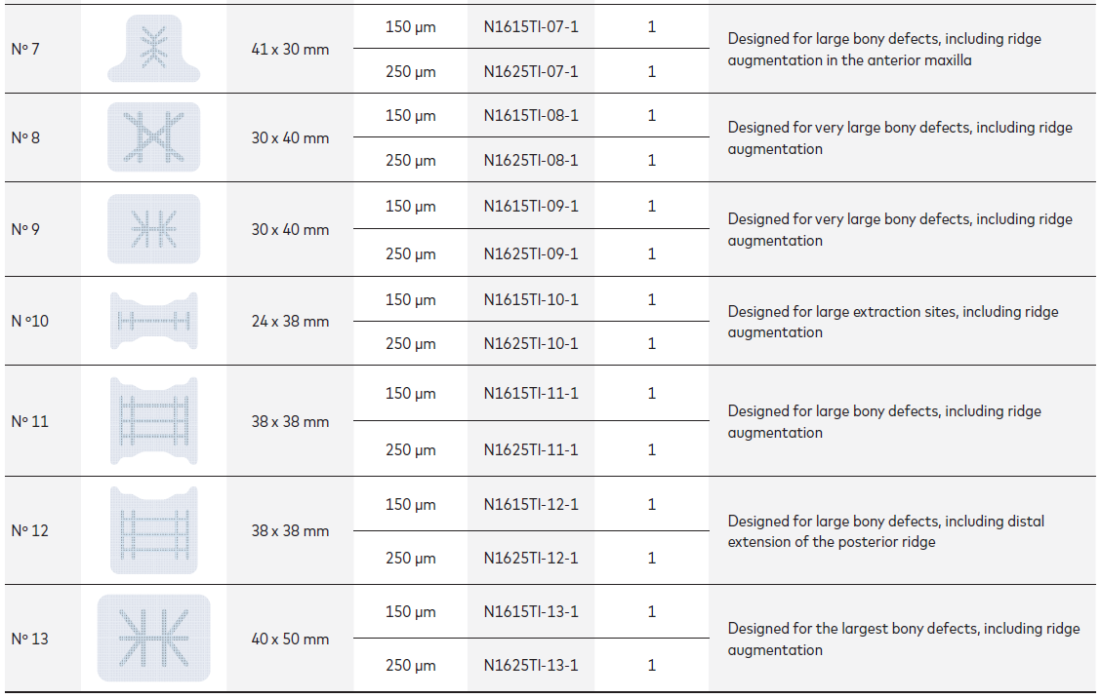

Slide 41
GMT73441 © Nobel Biocare Services AG, 2021 All rights reserved.
Disclaimer: Nobel Biocare, the Nobel Biocare logotype and all other trademarks are, if nothing else is stated or is evident from the context in a certain case, trademarks of Nobel Biocare. Please refer to nobelbiocare.com/trademarks for more information.
Product images are not necessarily to scale. All product images are for illustration purposes only and may not be an exact representation of the product.
Please contact the local Nobel Biocare sales office for current product assortment and availability. Disclaimer: For prescription use only. Caution: Federal (United States) law or the law in your jurisdiction may restrict this device to sale by or on the order of a dentist or a physician. See Instructions For Use for full prescribing information, including indications, contraindications, warnings and precautions
Cytoplast™ (Osteogenics Biomedical, Inc.) is distributed as creos™ syntoprotect since January 2021. Legal Manufacturer: Osteogenics Biomedical, Inc., 4620 71st Street, Bldg 78-79, Lubbock, TX 79424, USA and distributed by Nobel Biocare Services AG.

