Slide 1
Regenerative solutions
creos™ xenografts

Slide 2
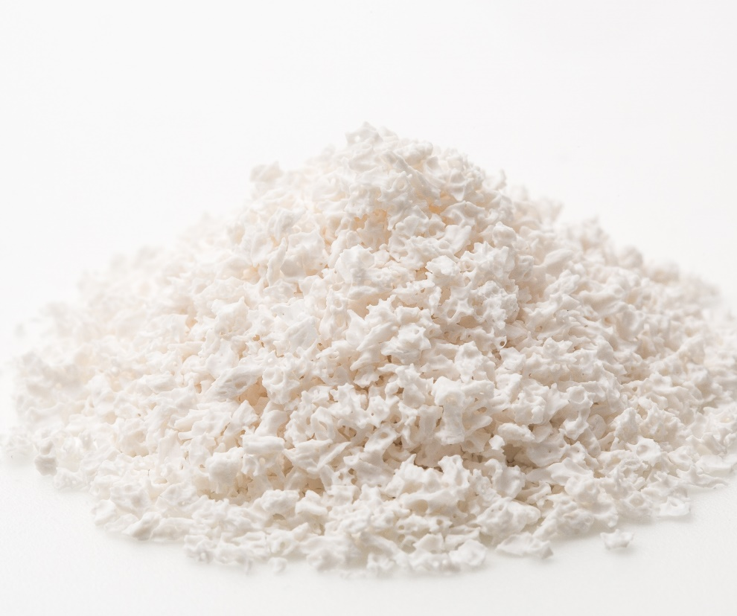
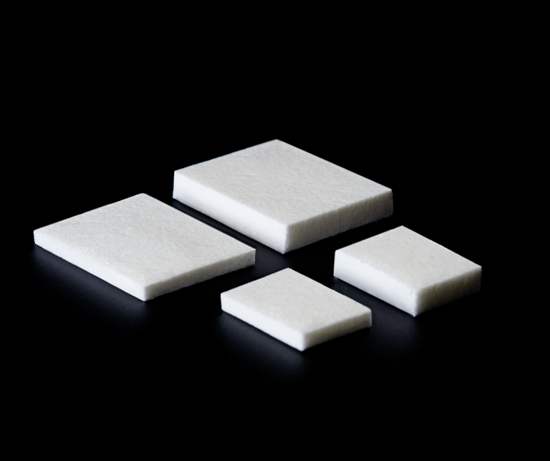
creos™ biomaterials
A comprehensive portfolio for soft tissue & bone regeneration
Membranes
creos™ xenoprotect
Bone Graft Substitutes
creos™ xenogain
Soft Tissue Matrix
creos™ mucogain

Slide 3


A membrane with
outstanding handling that facilitates bone gain
creos™ xenoprotect

Slide 4
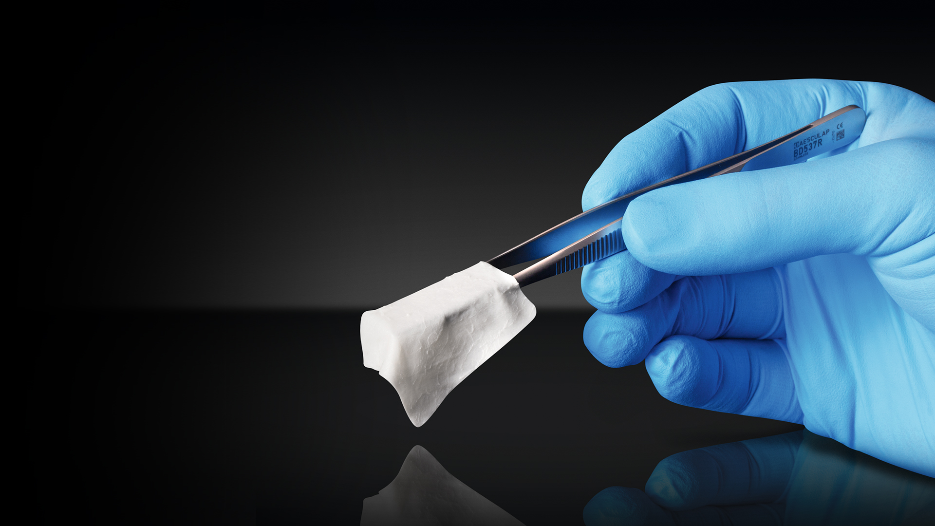
Einfache Handhabung
1. Outstanding handling
  Does not stick to instruments.
  Repositioning in-situ possible.
  Minimal size increase when hydrated.
2. High mechanical strength
Excellent suture retention.
Highly tear-resistant, making it easy to suture or fixate with pins.
3. Enduring resistance to degradation in vivo
  Manufacturing process intended to preserve the natural structure of the collagen fiber network, to confer a high resistance to degradation.
4. Facilitates bone gain
  Good clinical results.
  Excellent tissue compatibility.

Slide 5

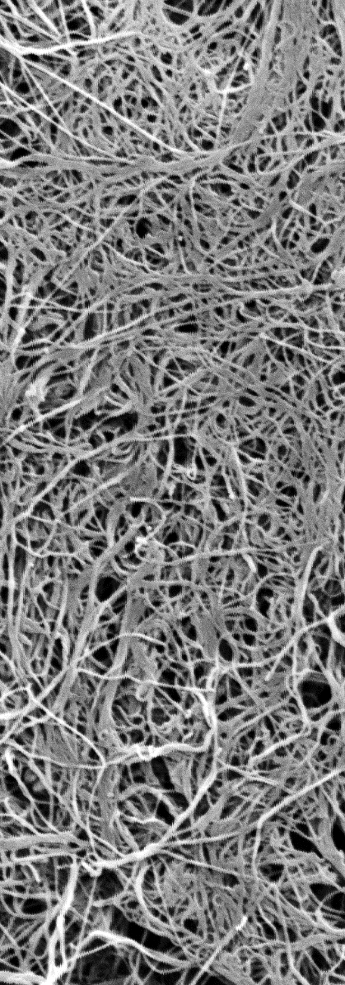
creos™ xenoprotect is a membrane composed of a network of highly purified porcine collagen and elastin fibers.
The manufacturing process is intended to preserve the natural structure of the collagen fiber network, to confer a high resistance to degradation.
A natural barrier with outstanding handling properties.
What is
creos™ xenoprotect?

Slide 6
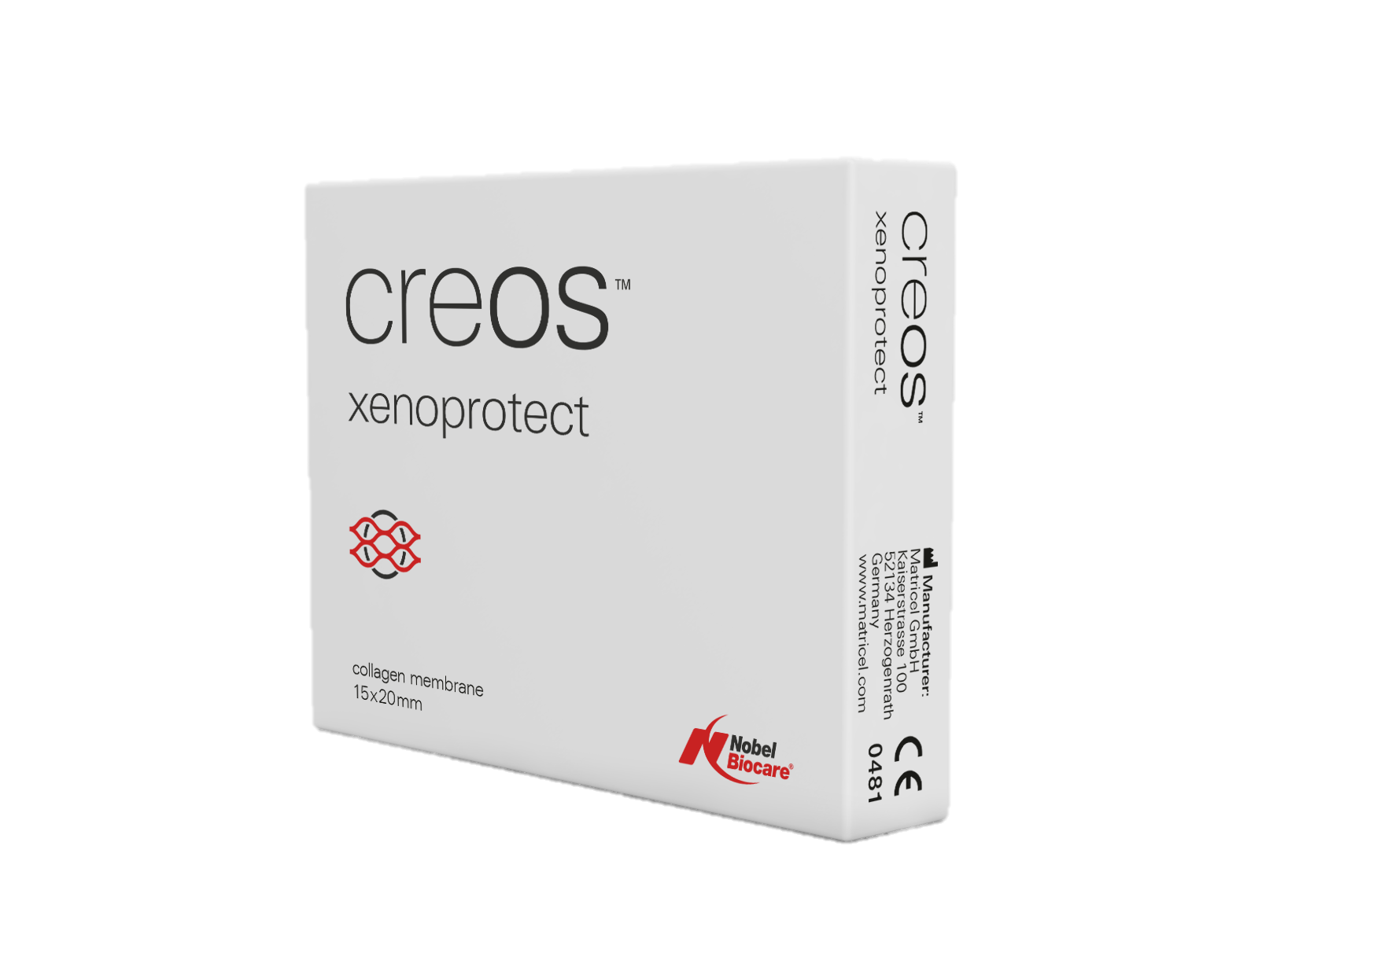
Available in 3 sizes
Article | Size
N1520 | 15x20 mm
N2530 | 25x30 mm
N3040 | 30x40 mm

Slide 7
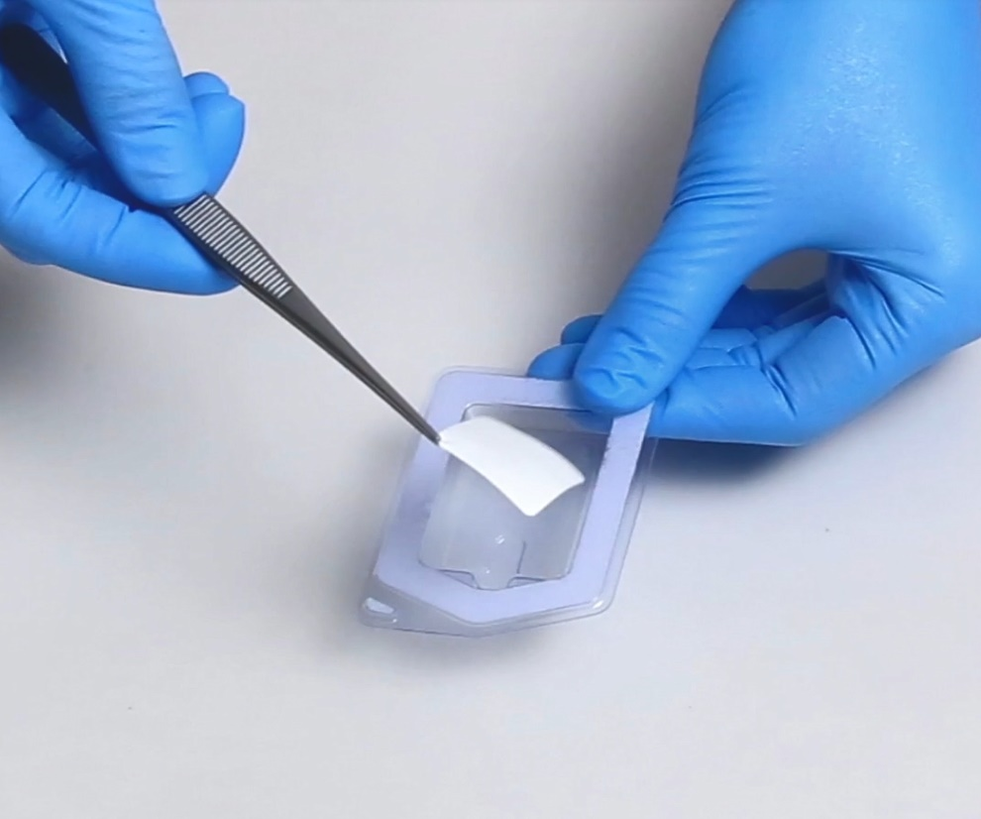
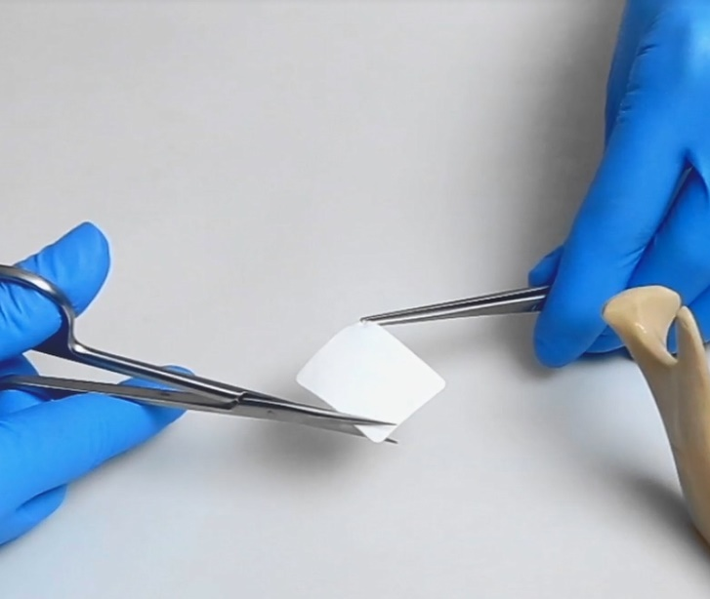
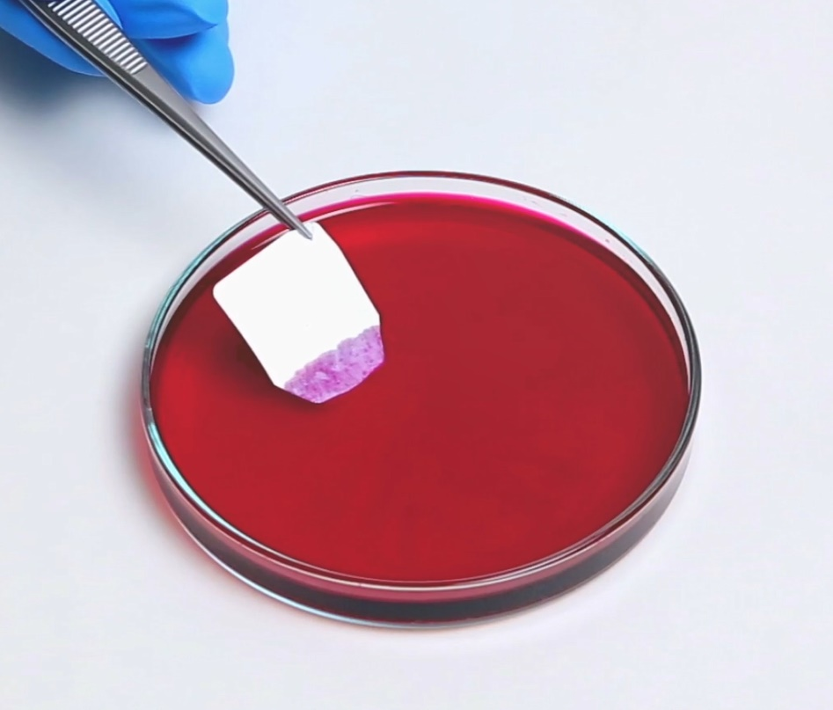
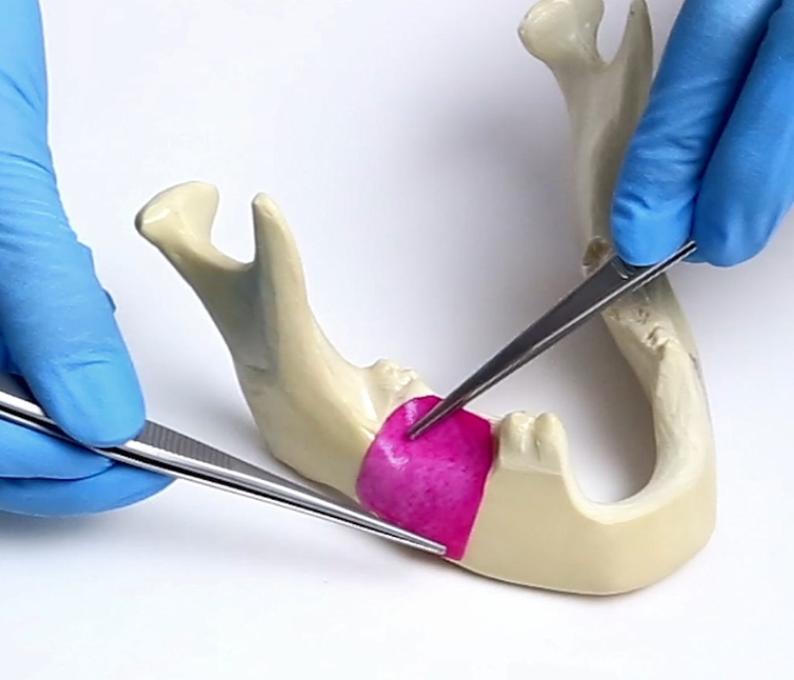
1. Outstanding handling
Both sides can face the defect
Easy to trim (dry or wet)
  Both sides can face the defect
  Easy to trim (dry or wet)
  Low surface expansion when hydrated.
  Does not stick to instruments, repositioning in-situ possible.
Low surface expansion when hydrated
Does not stick to instruments

Slide 8
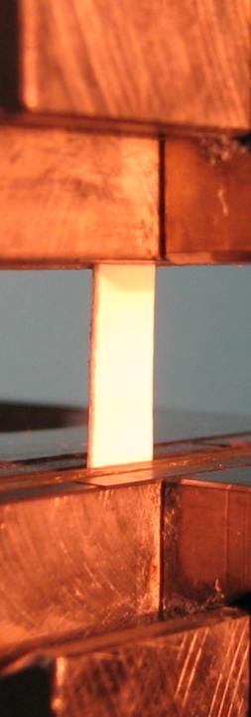
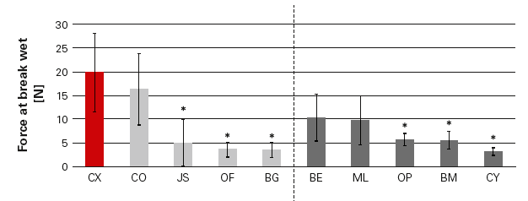
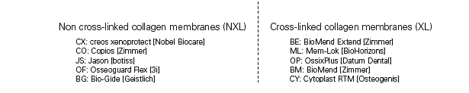
2. High mechanical strength and tear resistance#
* statistically significant
# as shown in an in vitro study
Gasser A, Wessing B, Eummelen L, et al. Mechanical stability of collagen membranes: an in vitro study. J Dent Res 2016;95(Spec Iss A): 1683

Slide 9
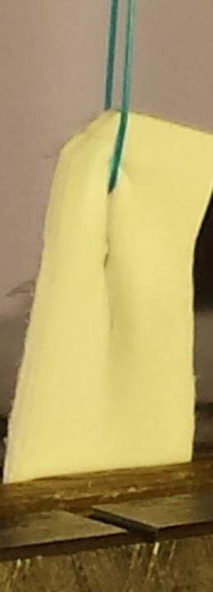
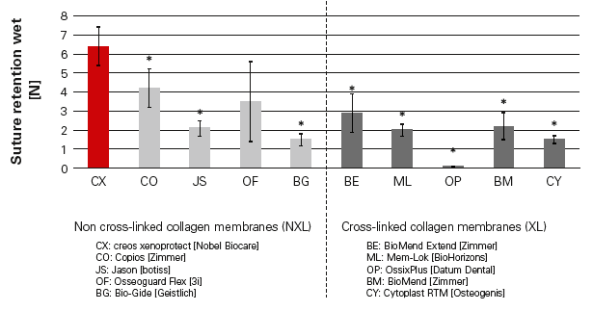
2. High suture resistance#
* statistically significant
# as shown in an in vitro study
Gasser A, Wessing B, Eummelen L, et al. Mechanical stability of collagen membranes: an in vitro study. J Dent Res 2016;95(Spec Iss A): 1683

Slide 10
3. Enduring resistance to degradation
Slower in vitro bio-degradation compared to another chemically non-crosslinked barrier membrane.
reference membrane
*
creos™ xenoprotect
* statistically significant
creos™ xenoprotect features an almost twofold lower degradation rate compared to a reference chemically non-crosslinked membrane when exposed to natural enzymes in vitro.
Bozkurt A, Apel C, Sellhaus B, et al. Differences in degradation behavior of two non-cross-linked collagen barrier membranes: an in vitro and in vivo study. Clin Oral Implants Res 2014; 25(12):1403-1411

Slide 11
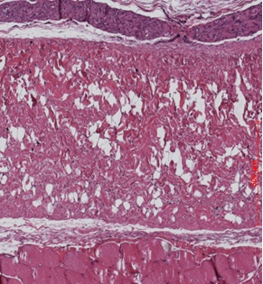
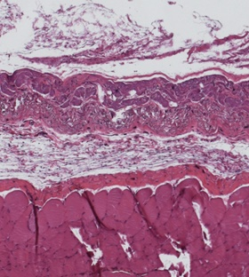
Histology 20 weeks
after implantation
3. Enduring resistance to degradation #
creos™ xenoprotect
1000
800
Initial thickness
creos™ xenoprotect
600
Initial thickness
creos™ xenoprotect
Membrane thickness [µm]
20 weeks after implantation
*
Initial thickness
reference membrane
reference membrane
400
200
Initial thickness
reference membrane
0
creos™ xenoprotect
reference membrane
* statistically significant
After 20 weeks, the thickness of creos™ xenoprotect decreased only slightly, whereas the reference membrane showed a thickness loss of around 50%, confirming the higher stability of creos™ xenoprotect against biodegradation in vivo.
# as shown in an animal model
(rat, subcutaneous)
Bozkurt A, Apel C, Sellhaus B, et al. Differences in degradation behavior of two non-cross-linked collagen barrier membranes: an in vitro and in vivo study. Clin Oral Implants Res 2014; 25(12):1403-1411

Slide 12
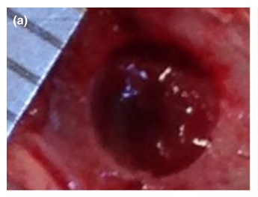
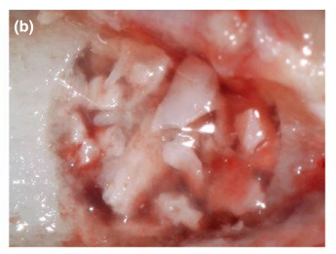
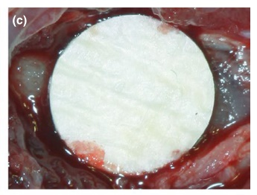
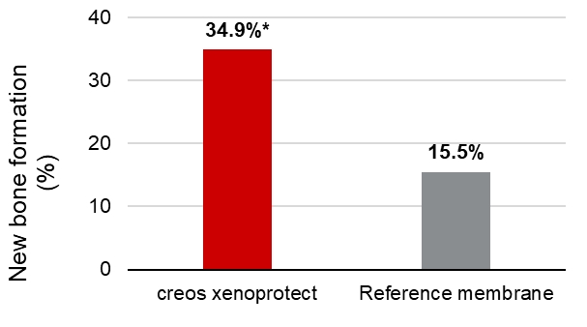
4. creos™ xenoprotect facilitates bone gain #
creos™ xenoprotect
or
reference membrane
Bone defect
Bovine bone grafts
* statistically significant
creos™ xenoprotect demonstrated significantly higher new bone formation in the central portion of the defect compare to the reference membrane.
Omar O, Dahlin A, Gasser A, et al. Tissue dynamics and regenerative outcome in two resorbable non-cross-linked collagen membranes for guided bone regeneration: A preclinical molecular and histological study in vivo. Clin Oral Implants Res 2018;29(1):7–19.
# as shown in an animal model (rat)

Slide 13
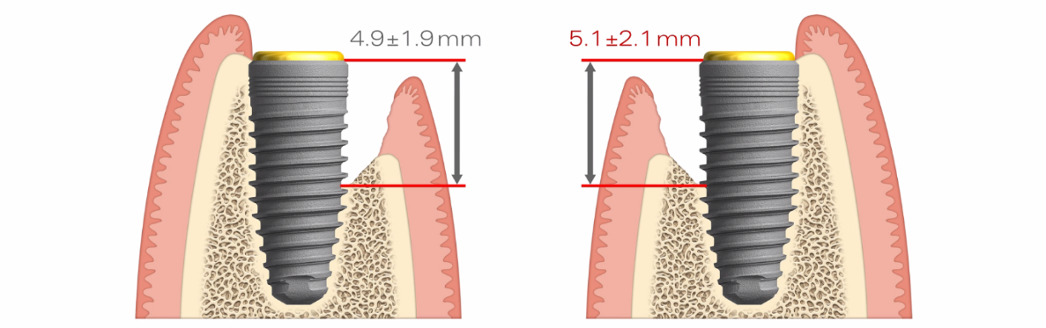
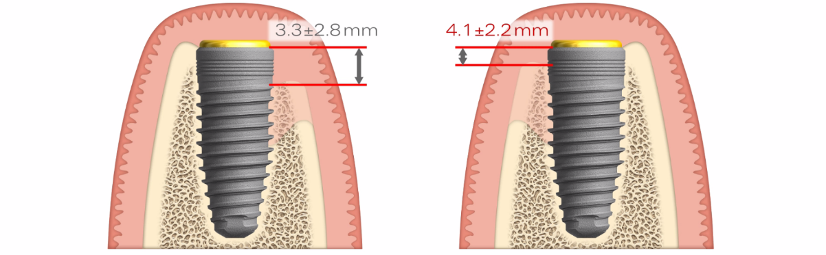
4. Good clinical results in the treatment of dehiscence defects
reference membrane
creos™ xenoprotect
Defect at implant insertion
Defect at re-entry (6 months)
Of the 49 included patients, 24 were treated with creos™ xenoprotect and 25 with a reference membrane.
For creos™ xenoprotect, the mean defect height at implant insertion was 5.1 ± 2.1 mm and reduced at reentry by 81%.
Wessing B, Emmerich M, Bozkurt A. Horizontal ridge augmentation with a novel resorbable collagen membrane: a retrospective analysis of 36 consecutive patients. Int J Periodontics Restorative Dent 2016;36(2):179–187.

Slide 14

1. Outstanding handling
Low surface expansion when hydrated.
Easy to trim (dry or wet) and does not stick to instruments.
Repositioning in-situ possible.
Both sides can face the defect.
2. High mechanical strength
Excellent suture retention.
Highly tear-resistant, making it easy to suture or fixate with pins.
3. Enduring resistance to degradation in vivo
Manufacturing process intended to preserve the natural structure of the collagen fiber network, to confer a high resistance to degradation.
4. Facilitates bone gain
  Good clinical results.
  Excellent tissue compatibility in vivo.
Why creos™ xenoprotect?

Slide 15
More scientific evidence is to be found in the following publications
Key scientific evidence, creos™ xenoprotect:
Gasser A, Wessing B, Eummelen L, et al. Mechanical stability of collagen membranes: an in vitro study. J Dent Res 2016;95(Spec Iss A): 1683
Bozkurt A, Apel C, Sellhaus B, et al. Differences in degradation behavior of two non-cross-linked collagen barrier membranes: an in vitro and in vivo study. Clin Oral Implants Res 2014; 25(12):1403-1411
Omar O, Dahlin A, Gasser A, et al. Tissue dynamics and regenerative outcome in two resorbable non-cross-linked collagen membranes for guided bone regeneration: A preclinical molecular and histological study in vivo. Clin Oral Implants Res 2018;29(1):7–19.
Wessing B, Emmerich M, Bozkurt A. Horizontal ridge augmentation with a novel resorbable collagen membrane: a retrospective analysis of 36 consecutive patients. Int J Periodontics Restorative Dent 2016;36(2):179–187.

Slide 16
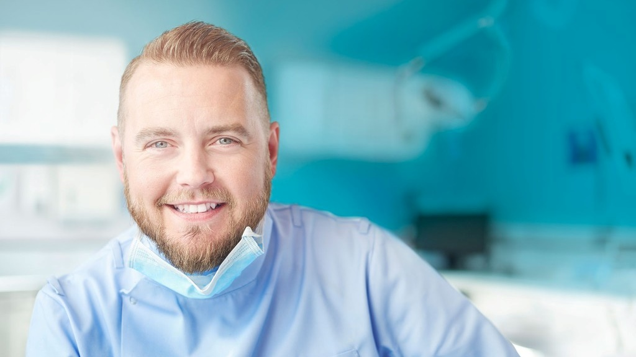

Soft tissue regeneration made smarter.
creos™ mucogain
Unique oriented porous structure designed for guided soft tissue regeneration

Slide 17
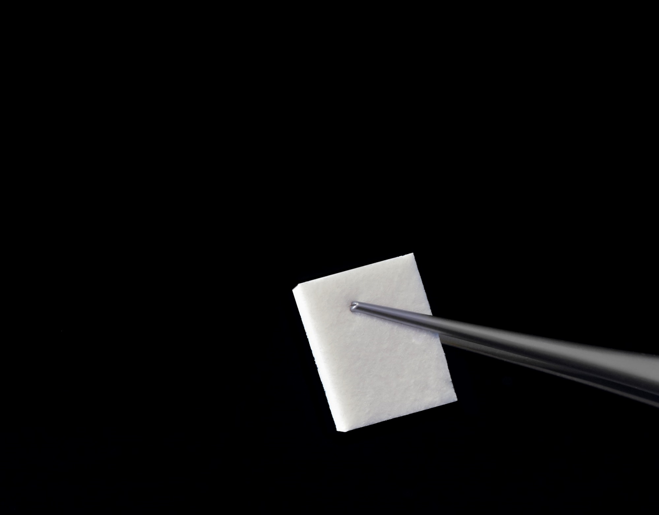
Substitutes the need for a second surgical site
(often associated with pain and bleeding for the patient)
2. Patented method
  Oriented open porous matrix structure.
  Designed to promote soft tissue regeneration through the migration of cells and blood vessels into the matrix.
3. Variety of choice
  A choice of different sizes and thicknesses.
  Designed to replace autologous grafts in several indications. ¹
4. Excellent handling
Easy to use.
High suture retention and stress resistance.
Memory effect after hydration and cycling loading in vitro.
Trim to precisely fit surgical site.
5 Clinically effective
  Shown to promote soft tissue health and maintain adequate soft tissue thickness in a clinical study. ²
¹ See Instructions For Use for full prescribing information, including indications, contraindications, warnings and precautions.
² Wessing B et al. Clinical Oral Implant Research 2019.

Slide 18
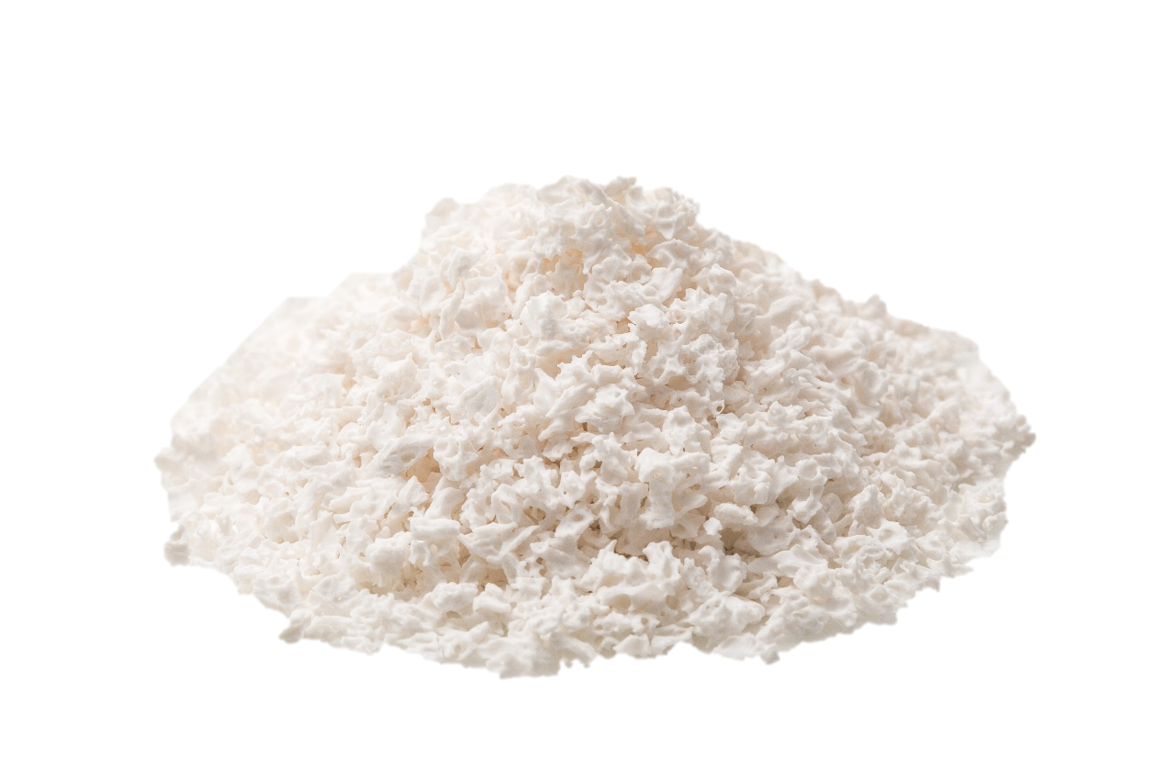

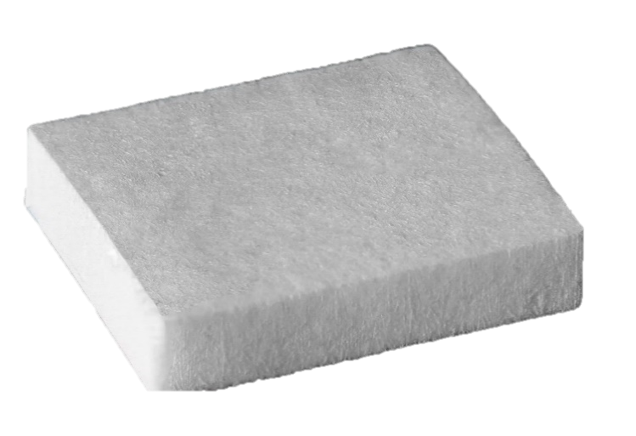
creos™ mucogain is a matrix of highly purified porcine collagen and elastin.
creos™ mucogain features oriented open pores thanks to a patented manufacturing method.
The resulting matrix features mechanical strength, stress resistance and a memory effect.
What is xenogain?
What is creos™ mucogain?

Slide 19
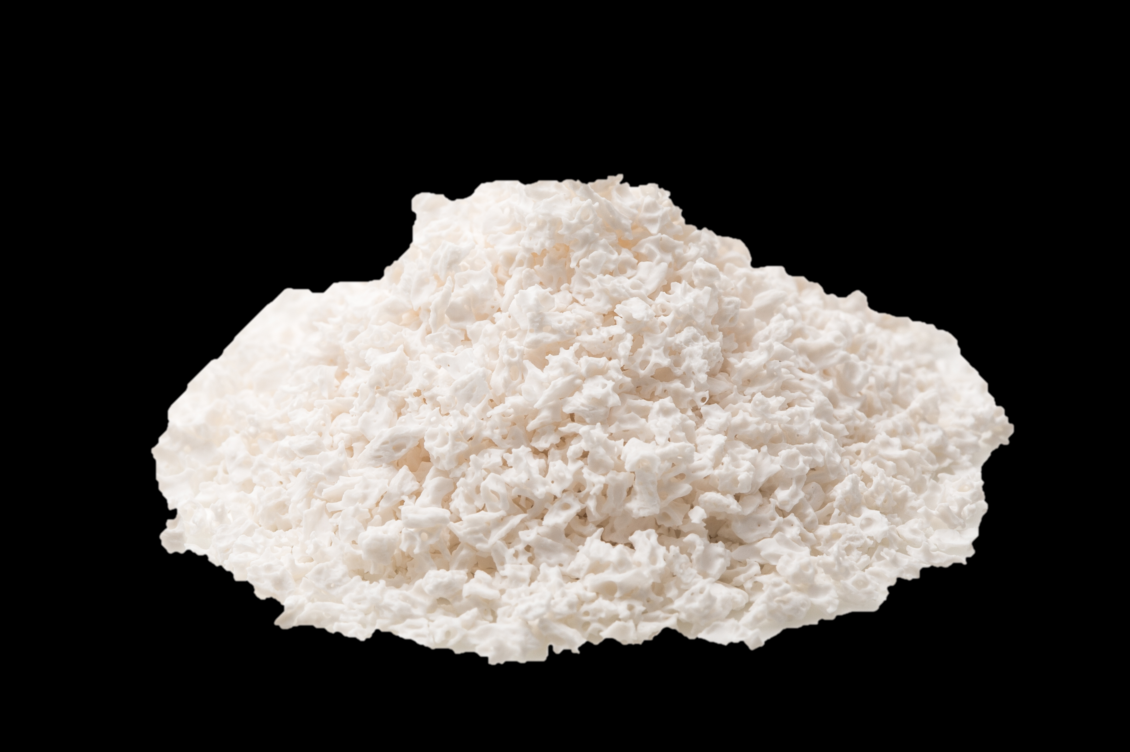
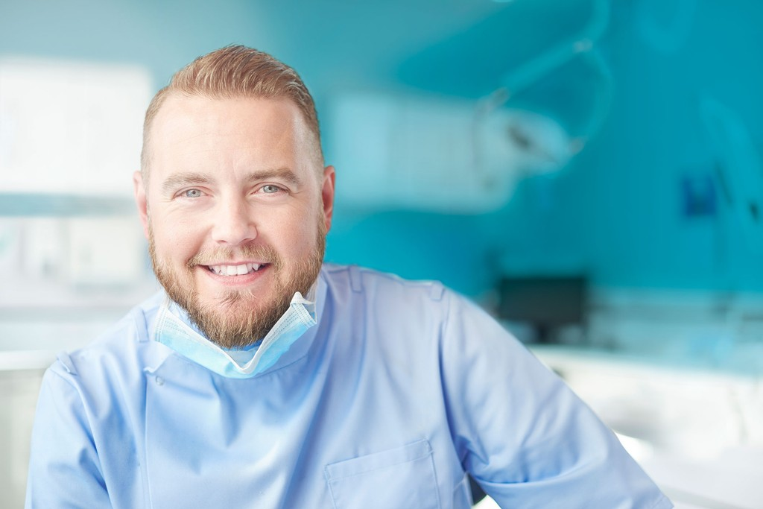
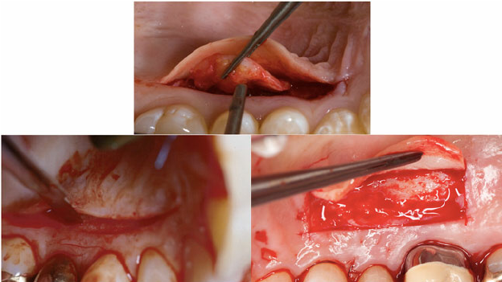
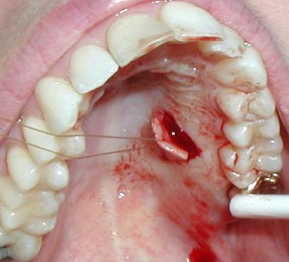
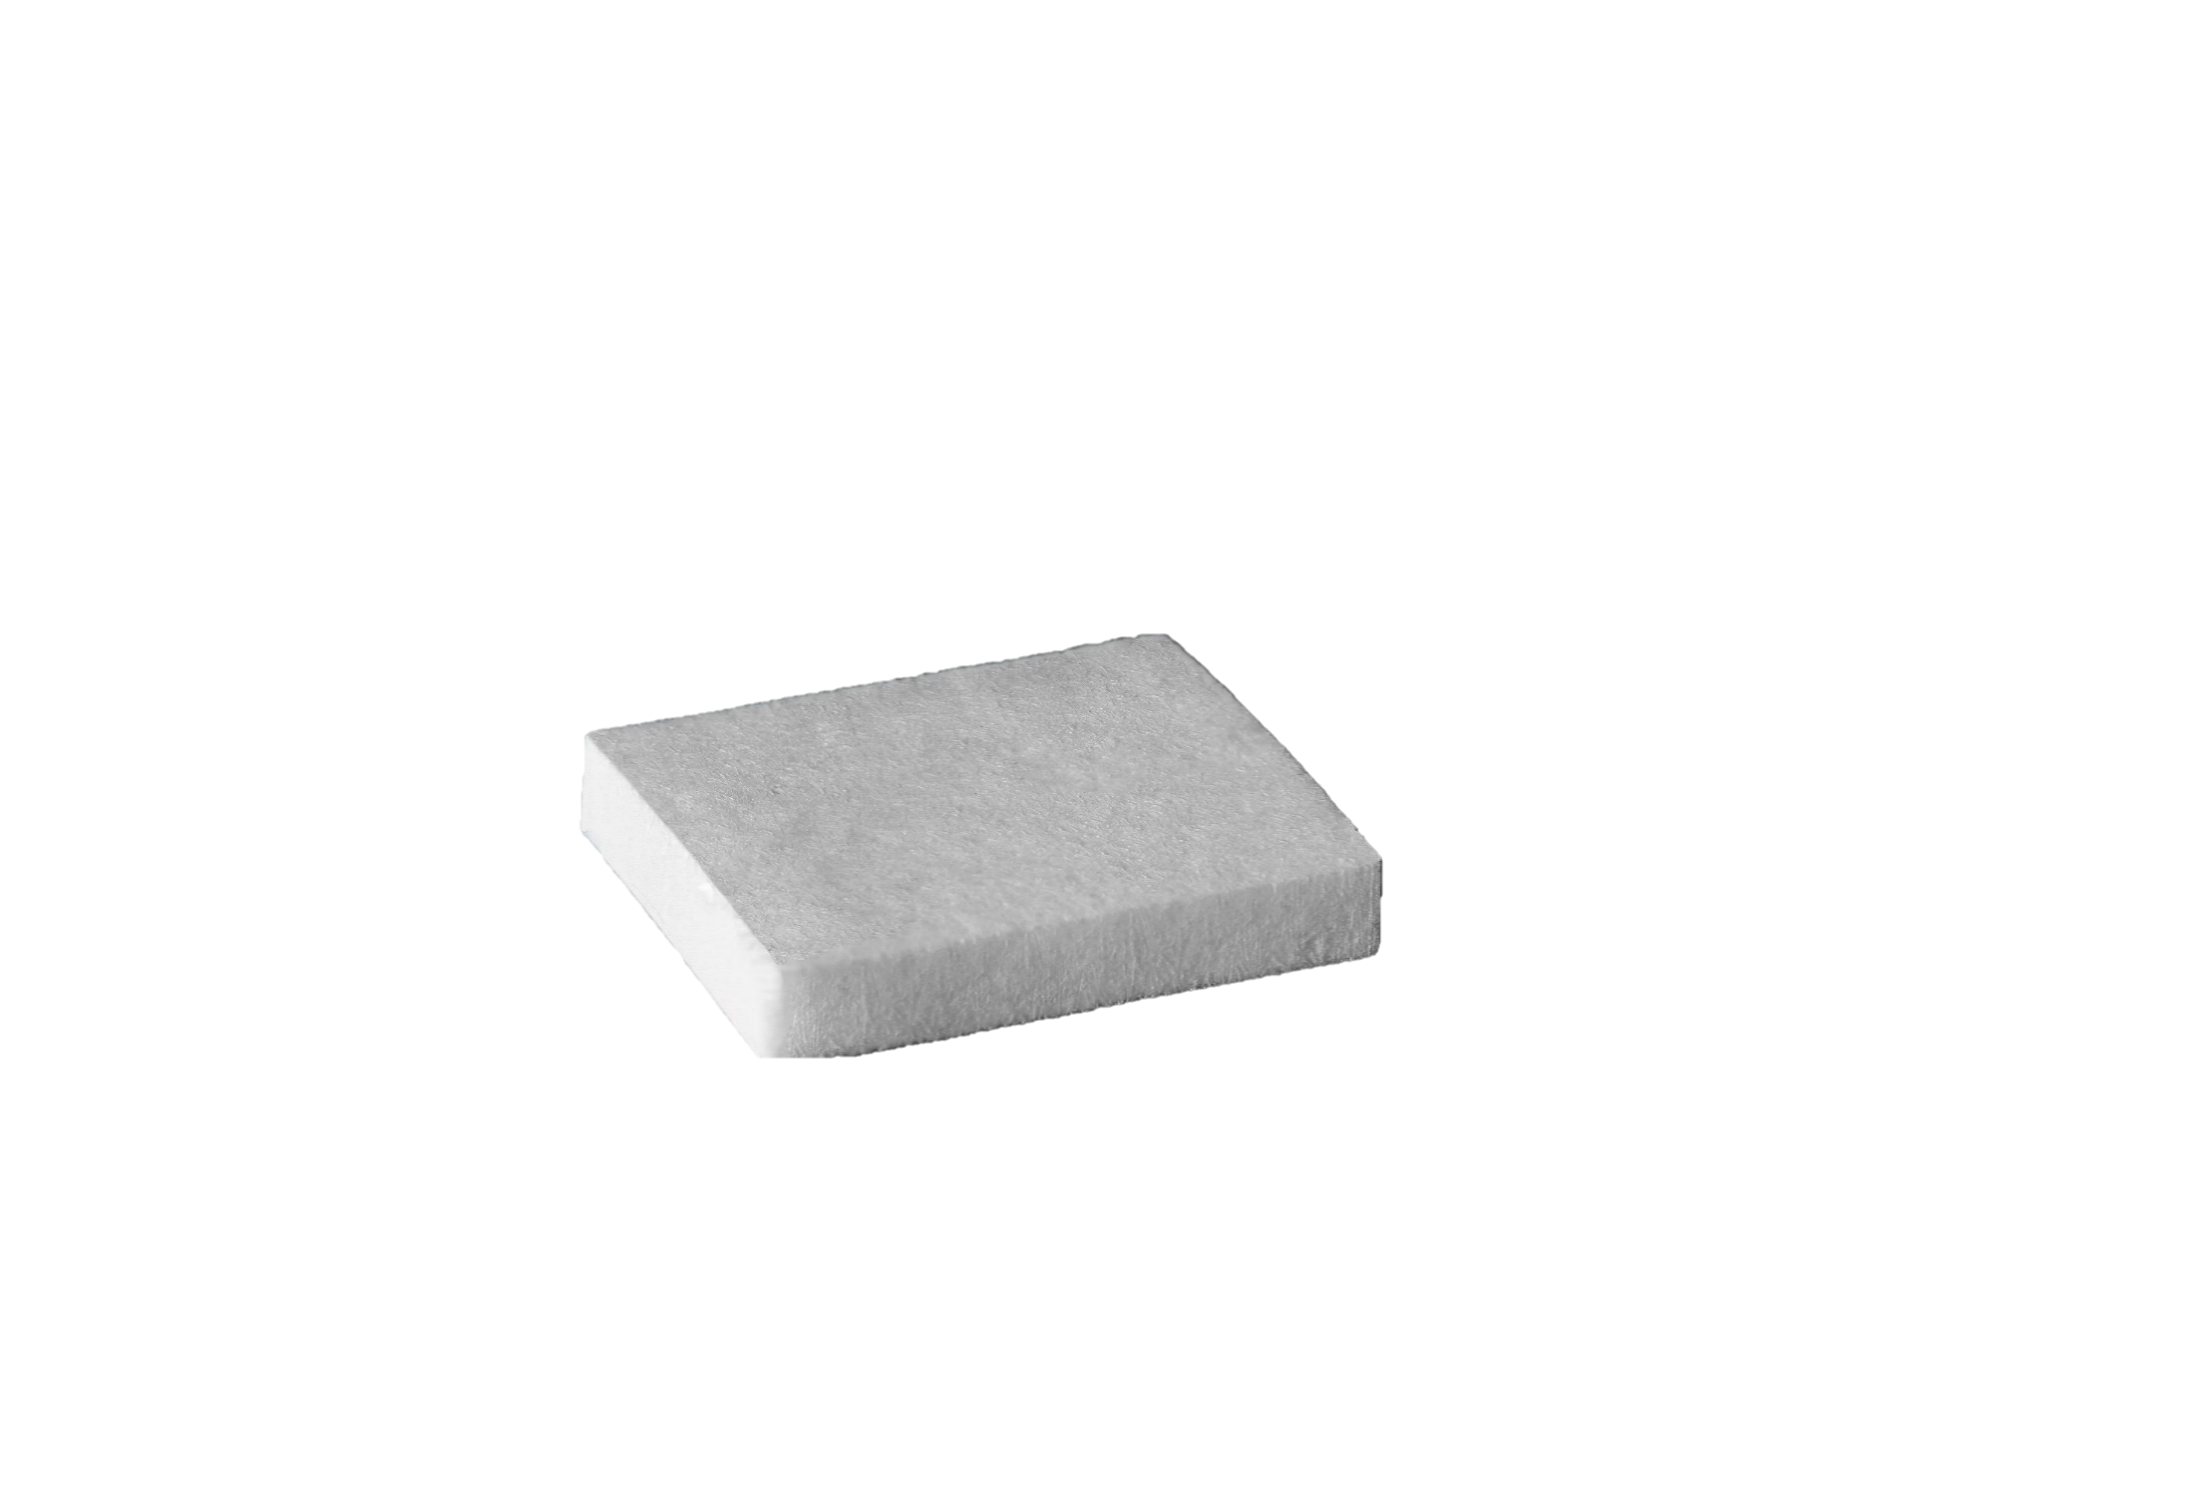
What is xenogain?
1. Substitutes the need for a second surgical site
No need for a second surgical site, which is associated with post-operative pain, bleeding, swelling and infection.¹
¹ Harris R.J 2005. Griffin T.J. et al.2006. Aguirre-Zorzano L.A. et.al 2017

Slide 20
What is xenogain?
2. A patented manufacturing process
Directional solidification method followed by freeze-drying.

Slide 21
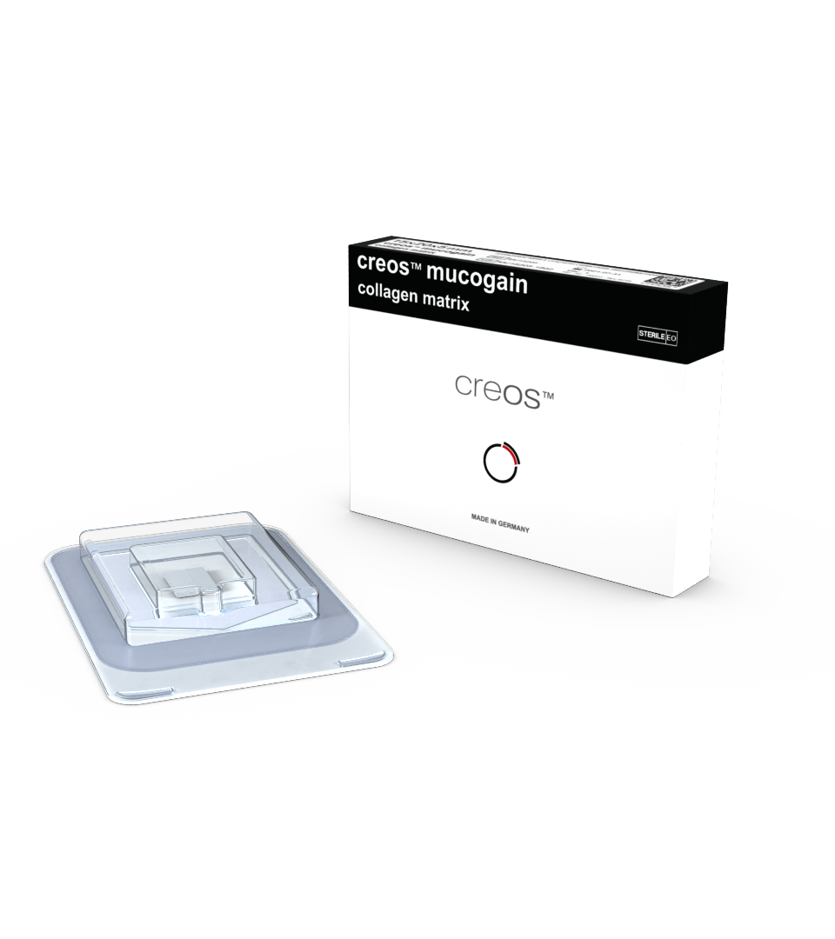
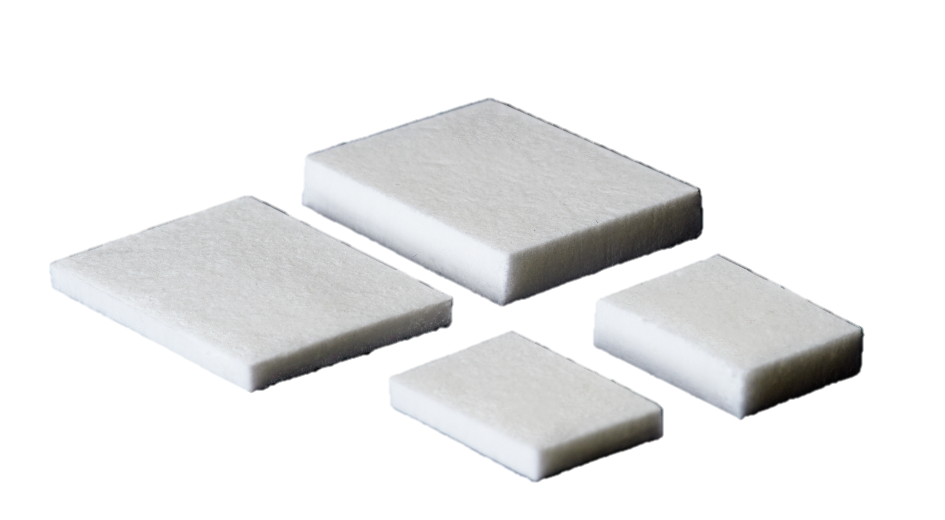
What is xenogain?
3. A variety of choice
Article | Size | Thickness
MU15203 | 15x20 mm | 3 mm
MU25303 | 25x30 mm | 3 mm
MU15205 | 15x20 mm | 5 mm
MU25305 | 25x30 mm | 5 mm

Slide 22
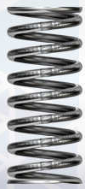

What is xenogain?
4. Memory effect
When hydrated, the initial volume of the graft is maintained after repeated compression
creos™ mucogain thickness
[% of initial size]
50
Damink O.L., Heschel I., Leemhuis H. et all. Soft tissue volume augmentation in the oral cavity with a collagen-based 3D matrix with orientated open pore structure. Current Directions in Biomedical Engineering 2018; 4(1): 237 – 241

Slide 23
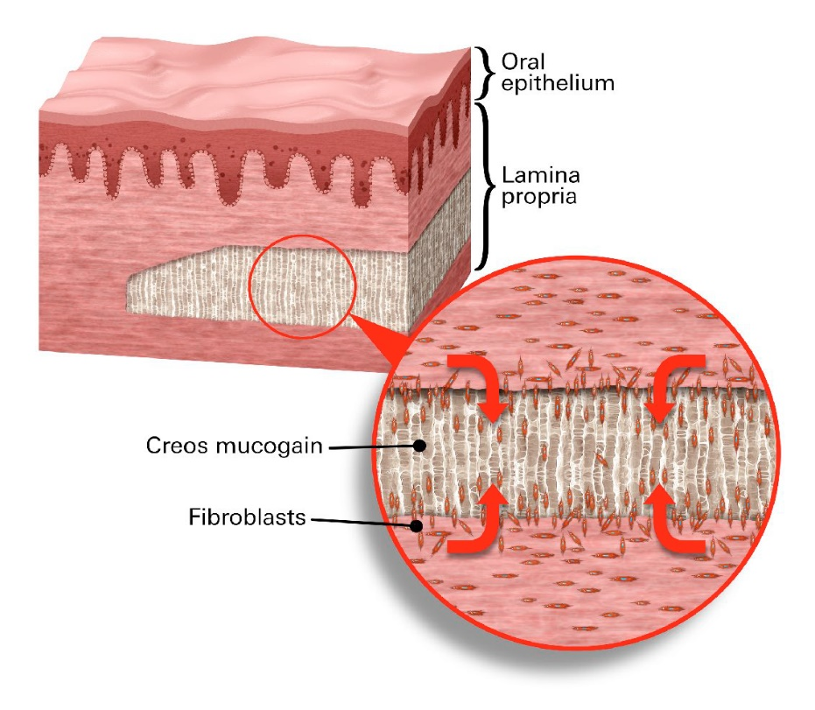
5. Designed to promote soft tissue regeneration through the migration of cells and blood vessels into the matrix.
Tissue integration and formation of new blood vessels due to the tube-like channel structure.
The matrix is replaced by newly formed autogenous soft tissue in vivo.
Damink O.L., Heschel I., Leemhuis H. et all. Soft tissue volume augmentation in the oral cavity with a collagen-based 3D matrix with orientated open pore structure. Current Directions in Biomedical Engineering 2018; 4(1): 237 – 241

Slide 24
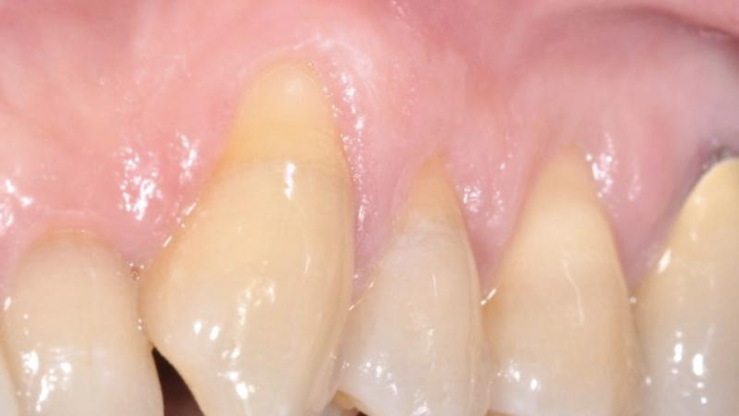
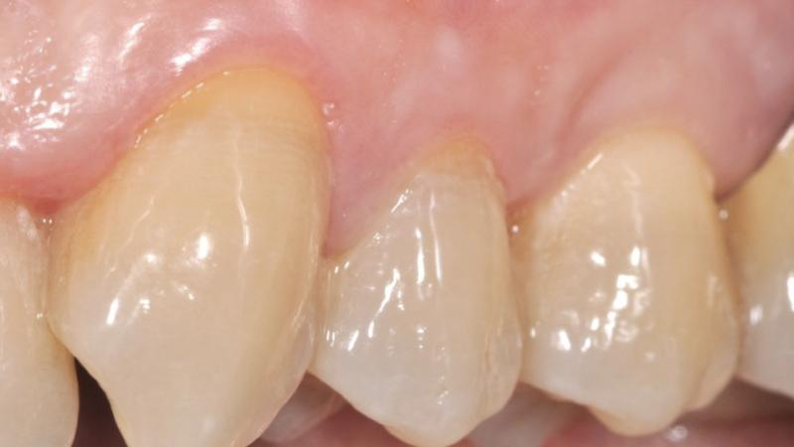
What is xenogain?
5. Clinically effective
creos™ mucogain shown to promote soft tissue health and maintain adequate soft tissue thickness.#
Initial situation
8 months post-treatment
Cirillo I, Encalada C, Periodontal plastic surgery: treatment of multiple gingival recessions. FOR.org
In 45 patients, a follow-up of up to 4.5 years (mean of 1.8 ± 1.3 years) demonstrated that creos™ mucogain promotes soft tissue health and maintains adequate soft tissue thickness.
# as shown in a clinical study:
Wessing B et al. Clinical Oral Implant Research 2019
Wessing B, Boekema B and Gonzalez-Martin. Soft tissue augmentation with a collagen-based 3D matrix with directed pore channels. Clinical Oral Implant Research 2019:Volume30, IssueS19.

Slide 25
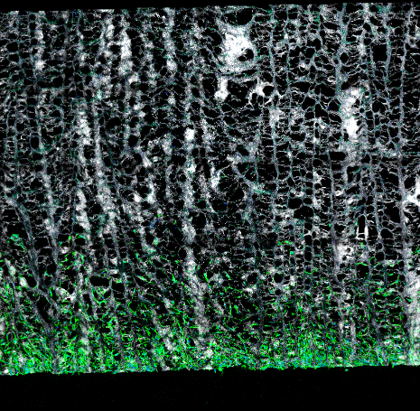
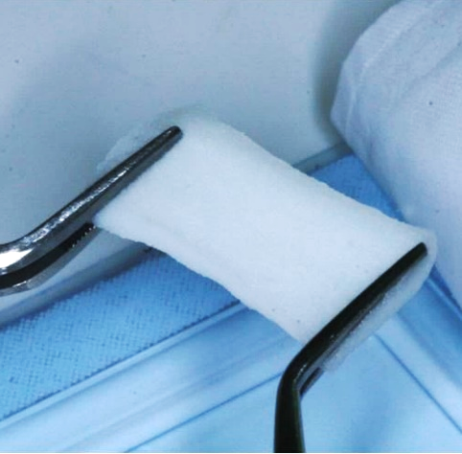
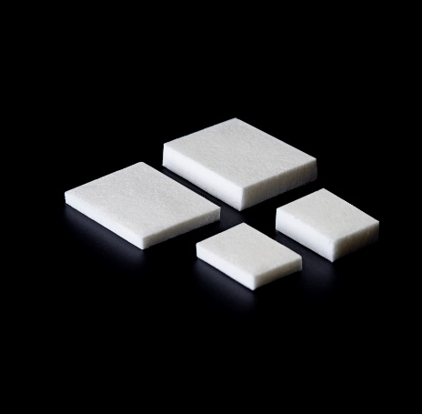
1. No need for a second surgical site
  A second surgical site is associated with post-operative pain, bleeding, swelling and infection.¹
2. Patented method
  Oriented pore structure
  Migration of cells into the matrix
3. Variety of choice
  Two thicknesses (3 & 5 mm)
4. Excellent handling
  Easy to use
  Memory effect, mechanical strength
5. Clinically effective
  Shown to promote soft tissue health and maintain adequate soft tissue thickness in a clinical study.²
Why creos™ mucogain ?
¹ Harris R.J 2005. Griffin T.J. et al.2006. Aguirre-Zorzano L.A. et.al 2017.
² Wessing B et al.. Clinical Oral Implant Research 2019.

Slide 26
More scientific evidence is to be found in the following publications
Key scientific evidence, creos™ xenogain:
Boekema B., Vlig F, Damink O.L. et al. Effect of pore size and cross-linking of a novel collagen-elastin dermal substitute on wound healing. J Mater Sci Mater Med 2014:25(2):423-433
Wessing B, Boekema B and Gonzalez-Martin. Soft tissue augmentation with a collagen-based 3D matrix with directed pore channels. Clinical Oral Implant Research 2019:Volume30, IssueS19.
Wessing B, Vasilic N. Soft tissue augmentation with a new regenerative collagen 3-D matrix with oriented open pores as a potential alternative to autologous connective tissue grafts. Clin Oral Implants Res. 2014 Sep;25(s10)
Sanz-Martin I, Encalada C, Sam-Sanchez I, et al. Soft tissue augmentation at immediate implants using a novel xenogeneic collagen matrix in conjunction with immediate provisional restorations: A prospective case series. Clin Implant Dent Relat Res 2019;21(1):145-153.

Slide 27


creos™
creos™

Slide 28
GMT69057 © Nobel Biocare Services AG, 2020. All rights reserved. Distributed by: Nobel Biocare. Legal manufacturer for creos™ xenoprotect and creos™ mucogain is Matricel GmbH, Kaiserstrasse 100, D-52134 Herzogenrath, Germany.
Nobel Biocare, the Nobel Biocare logotype and all other trademarks are, if nothing else is stated or is evident from the context in a certain case, trademarks of Nobel Biocare. Please refer to nobelbiocare.com/trademarks for more information.
Product images are not necessarily to scale. All product images are for illustration purposes only and may not be an exact representation of the product.
Disclaimer: Some products may not be regulatory cleared/released for sale in all markets. Please contact the local Nobel Biocare sales office for current product assortment and availability.
For prescription use only. Caution: Federal (United States) law restricts this device to sale by or on the order of a licensed clinician, medical professional or physician. See Instructions For Use for full prescribing information, including indications, contraindications, warnings and precautions.

